Slide 1
Welcome to AGLS & DTLS (Kathmandu, March 21, 2026)
Roles & Responsibilities of District Committee Chairs
PP Jayendra Rimal
Rotary District Training Faculty

Slide 2
Purpose of the Session
Clarify expectations
Align with Rotary priorities
Strengthen leadership

Slide 3
Questions?
As an individual, how many roles do you have?
What are your responsibilities?

Slide 4
Discussion Points on Committees
How does your Committee contribute to RI’s and District’s goals?
What are the challenges you may face in this role?
Who will you need to work at the District level? Club level?
How will you identify which Clubs to work with?

Slide 5
Discussion Points on Committees
What information do Clubs need from your Committee?
What are the most effective ways to communicate this information?
What is your plan for supporting weak Clubs?

Slide 6
Effective District Committee
1. PREPARE YOUR COMMITTEE:
Set up a Committee meeting to explain the work of the Committee and its goals for the year.
Help Committee members understand their roles.
Invite input from new members, as they may have fresh perspectives and experiences that will keep your Committee dynamic.

Slide 7
Effective District Committees
2. SET GOALS
Design Committee goals that are consistent with the RI’s and District’s goals.
Develop an action plan with responsibility for each goal.
Decide how you’ll measure success. KPIs?
Regularly monitor & evaluate the progress and adjust goals, if necessary.

Slide 8
Effective District Committees
3. MOTIVATE MEMBERS
Invite members to give regular progress reports.
Create opportunities for fellowship and networking.
Give tasks that corresponds to each member’s expertise.
Ask each member for their ideas and be open to acting on them.

Slide 9
Effective District Committees
4. PLAN PRODUCTIVE MEETINGS
Structure your Committee meetings to promote communication, feedback, and idea-sharing.
Create a clear agenda for each meeting.
Provide members with materials in advance.
Share meeting decisions among members.

Slide 10
Effective District Committees
5. DELEGATE TASKS
Focus on the most important tasks by assigning responsibilities to Committee members.
Check on progress periodically and give feedback.
Assign tasks to those who have the expertise and the time, to carry them out.

Slide 11
Effective District Committees
6. CULTIVATE FUTURE LEADERSHIP
Assign tasks that could prepare members for greater leadership responsibilities.
Empower members to make decisions and take ownership of projects.
Offer challenges beyond members’ existing skill level.

Slide 12
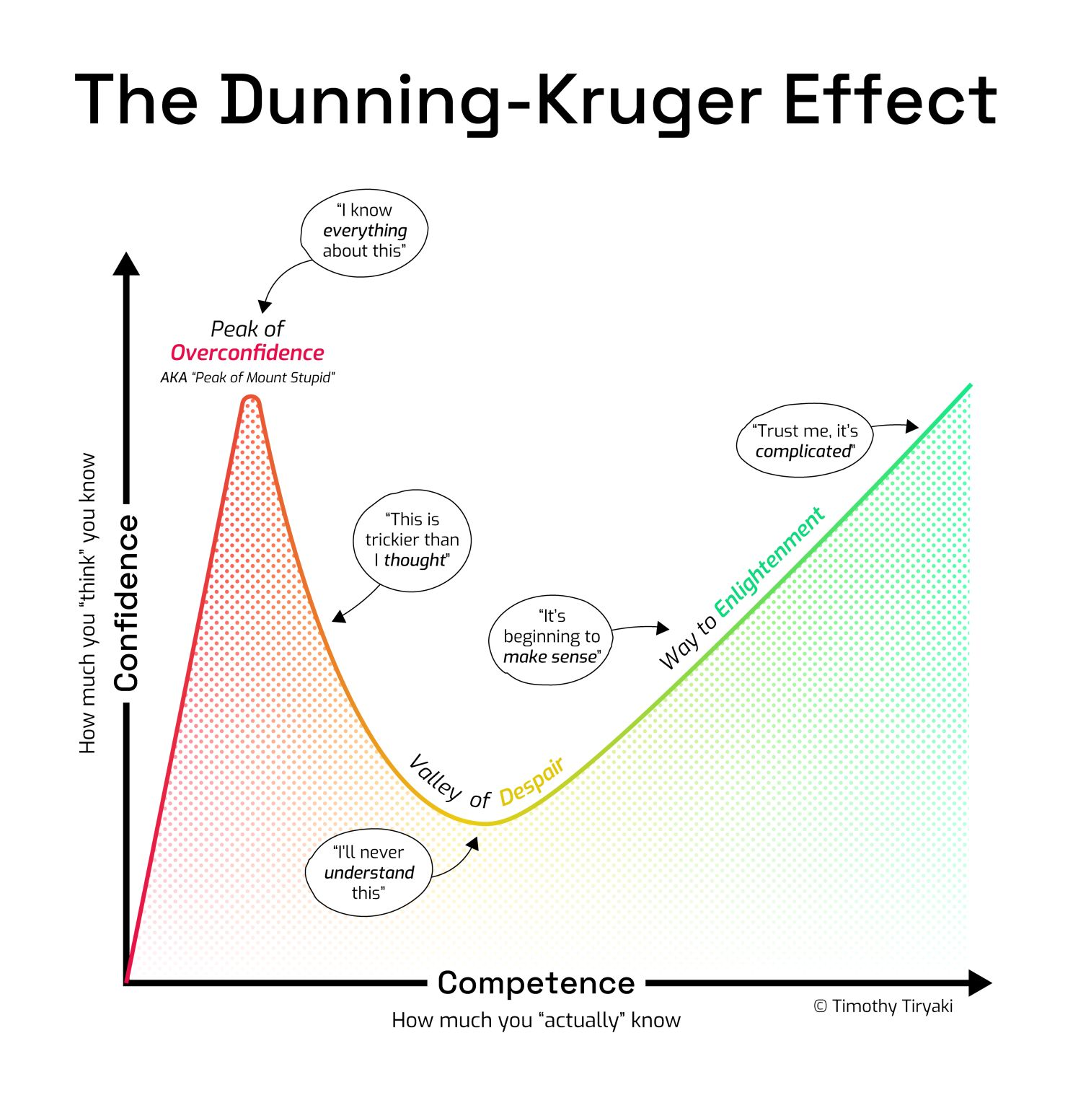
It’s a cognitive bias where:
people with limited knowledge or expertise in a subject often overestimate their abilities, while
those with greater competence tend to underestimate their expertise.

Slide 13
Imposter Syndrome
It is a psychological phenomenon where individuals doubt their abilities, achievements, or qualifications, often feeling like a fraud despite evidence of their success.
Addressing imposter syndrome often involves building self-awareness, reframing negative self-talk, seeking constructive feedback, and recognizing the value of one’s contributions.

Slide 14
And Finally
AS THE DISTRICT COMMITTEE CHAIRS, IT IS YOUR JOB TO INSPIRE CLUBS.
THE CLUBS SHOULD LOOK AT YOU AND SAY:
“BECAUSE OF YOU WE DID NOT GIVE UP”
2025-26 DTLS and AGLS | 14

Slide 15
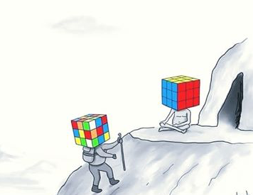
Thank you for attending
Questions???

