Slide 1
Importance of The Rotary Foundation
PDG CA Jitendra B Rajbhandary
ARMC 2025-26, TRF Cadre Coordinator 2017-26, DLF 2024-25 & 2025-26, DRFC 2016-2019

Slide 2


Slide 3


Slide 4
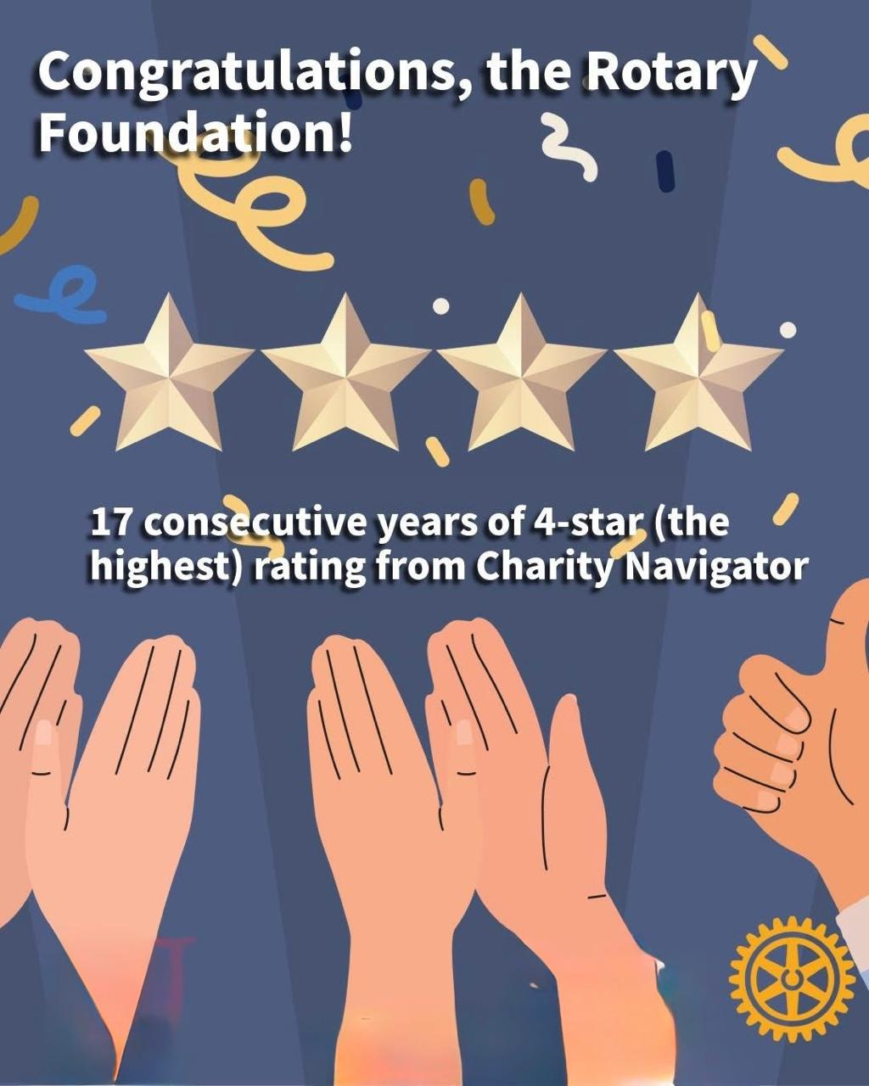

Slide 5
The Rotary Foundation
One of the World’s leading Humantarian Foundations
Supports Rotary’s mission of Service Above Self
Supported by contributions from Rotarians worldwide

Slide 6
What does Foundation do?
The Rotary Foundation transforms your gifts into Service Projects that changes lives both close to home and round the world
Since it was founded in 1917 by Arch C. Klumph, the Foundation has spent more than $ 4 billion on life changing, sustainable projects
At present. It provides grants of over $ 1 million per day to support projects led by us Rotarians

Slide 7
Why growing TRF matters?
Enables larger humanitarian projects
Strengthens District and Global Grants
Expands Community Impact
Builds Rotary’s Global reputation

Slide 8
Service Areas
Humanitarian
Scholarship
Vocational Training Team (VTT)

Slide 9
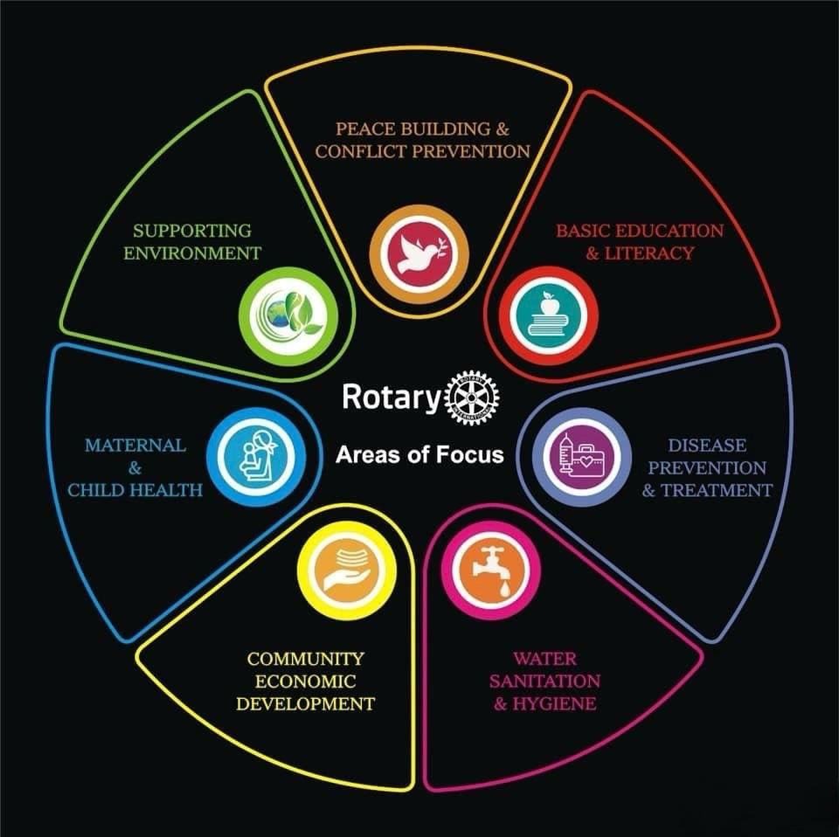

Slide 10
Successful Grant Projects
Fulfill community needs
Measurable outcome
Involvement of partner
Sustainable
Implementation plan
Stewardship

Slide 11
Types of Grants
District Grant
Global Grant
Disaster Response Grant
Program of Scale Grant

Slide 12
Applying for Global Grants
Minimum budget – USD 30,000
Involvement of at least 2 rotary clubs, host and international
Club meets qualification requirements
If DDF is required, approval from DRFC and DG
Clubs are expected to contribute towards project funding
Online application @rotary.org

Slide 13
Reporting
Progress reports Within 12 months of first payment
Every 12 months through the life of the grant project
Final report within 2 months of completion

Slide 14
How Rotarians can support TRF?
Annual Fund Contributions
Endowment Fund Gifts
Polio Plus Contributions
Restricted Giving: Global Grant/ Term Gift

Slide 15
Encourage Giving
Whatever you can, which is going to help some poor somewhere in the world with better education, health etc.
Every giving to the APF/ Investment Income of Endowment Fund is effective giving as over 90% goes for the cause
TRF does not depend on MD or AKS, more than 65% to 70% comes from small giving of $ 25 to $ 1,000

Slide 16
Strengthen Foundation
Promote Slogan that Rotary is the Brand that unites us
Encourage members to share stories to energize other club members, helps build Public Image, attract more members to contribute
Attract Corporate Houses/ Local Authorities for partnership with Rotary for projects
Tell members that when you go out to help the needy one, then you will realize how powerful you are

Slide 17


Slide 18
Strengthen Foundation
Encourage clubs to recognize contributors (Time/ Talent/ Treasure) in club meetings and also when District Officials and non Rotarian Guests are present
Encourage family members participation in such meetings
Recommend for recognition of contributors in District/ Region Level Programs
This will encourage future commitments from members

Slide 19
Strengthen Foundation
Inspire Clubs to give to the Foundation (T/T/T) and participate in its activities
Promote Foundation Grants and activities and help members participate in them
Ensure your club attend the Grant Management Seminar to qualify the clubs for Rotary Grants
Ensure your club sign MOU with District before June 2026 to be eligible for Grants

Slide 20



Slide 21
Take Away
Growing the Rotary Foundation strengthen Rotary’s Ability to Serve
No one has become poor by giving
Together we can support our District, TRF and make a Lasting Global Impact

Slide 22


Slide 23
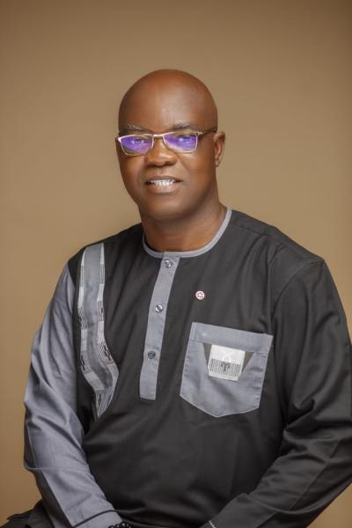
RI President 2026-2027 Olayinka Hakeem Babalola

Slide 24

RI Presidential Message

