Slide 1

Roles & Responsibilities
ASSISTANT GOVERNORS
Are we ready?
Notes:
To use this title animation slide with a new image simply 1) move the top semi-transparent shape to the side, 2) delete placeholder image,
3) click on the picture icon to add a new picture, 4) Move semi-transparent shape back to original position, 5) Update text on slide.

Slide 2
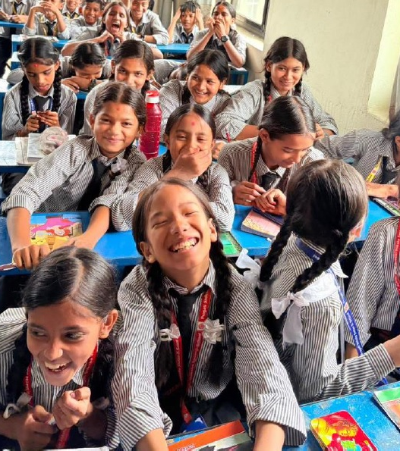
1
One Word That Comes to Your Mind When You Hear
‘Assistant Governor’
BRIDGE
MENTOR
SUPPORTER
COACH

Slide 3
2
Are You The
BOSS or SUPERVISOR of Your Assign Clubs?
District Governor’s Official Representative
To help your clubs become Stronger, more Effective, and more Engaged
In simple words:
You are a coach, mentor, cheerleader, relationship-builder, and early problem-solver.

Slide 4
I am the Connecting Link that makes Rotary
Stronger at the Club Level.
Key point to remember always:
Strong relationships with club presidents,
secretaries, and board members will determine
your success more than anything else.

Slide 5
Interactive
BRAINSTORM.
Let’s Do It!
Notes:
To use this title animation slide with a new image simply 1) move the top semi-transparent shape to the side, 2) delete placeholder image,
3) click on the picture icon to add a new picture, 4) Move semi-transparent shape back to original position, 5) Update text on slide.

Slide 6
RESPONSIBILITIES
Key Responsibilities
Building Relationships & Communication
Supporting Club Goals & Effectiveness
Monitoring, Reporting & Club Health
Coordinating Visits & District Initiatives
  For each heading,
  list specific actions an
  Assistant Governor should do.
  Think practically.
  What will you actually do?

Slide 7
BUILDING RELATIONSHIPS & COMMUNICATION
        Serve as the District Governor’s official representative to your clubs.
        Build trusting, cooperative relationships with club leaders.
        Facilitate two-way communication
        Promote district events, training, and Rotary Foundation programs.
SUPPORTING CLUB GOALS & EFFECTIVENESS
        Help clubs to develop realistic, aligned goals and enter them into Rotary Club Central.
        Provide guidance, resources, and mentoring to help clubs improve their effectiveness
        Assist clubs in overcoming challenges, resolving conflicts, and accessing Rotary tools and training.
Monitoring, Reporting & Club Health
        Regularly monitor key club health indicators
        Visit each club regularly.
        Conduct club ratings or assessments in Club Central.
        Keep the Governor informed about club progress, successes, and any challenges.
        Track compliance with reporting obligations and deadlines.
Coordinating Visits & District Initiatives
        Assist clubs in preparing for the Governor’s official visit.
        Encourage and coordinate club involvement in district projects, events, campaigns and service activities.
Notes:
Combine an image and multiple key statements with a strong grid.

Slide 8
The World has
CHANGED.
Have We?
Notes:
To use this title animation slide with a new image simply 1) move the top semi-transparent shape to the side, 2) delete placeholder image,
3) click on the picture icon to add a new picture, 4) Move semi-transparent shape back to original position, 5) Update text on slide.

Slide 9
CHALLENGES
COMMON CHALLENGES
        Motivating struggling or inactive clubs.
        Ensuring timely reporting and dues payment.
        Handling difficult conversations.
        Engaging and motivating all clubs
        Dealing with different levels of club performance.
        Acting as an effective bridge.
        What do you think will be the biggest challenge you may face as an Assistant Governor?
        And What skill or quality will help you overcome it?
SUCCESS TIPS
        Start building relationships immediately & schedule your first club visits early.
        Listen more than you speak during club visits.
        Focus on service impact, not just administration.
        Use Rotary tools: Club Central, Learning Center, RID3292 System.
        Collaborate with other AGs and the district team BECAUSE you are not alone.
        Celebrate small wins frequently to keep energy high.
        Communicate clearly and promptly with the Governor.

Slide 10
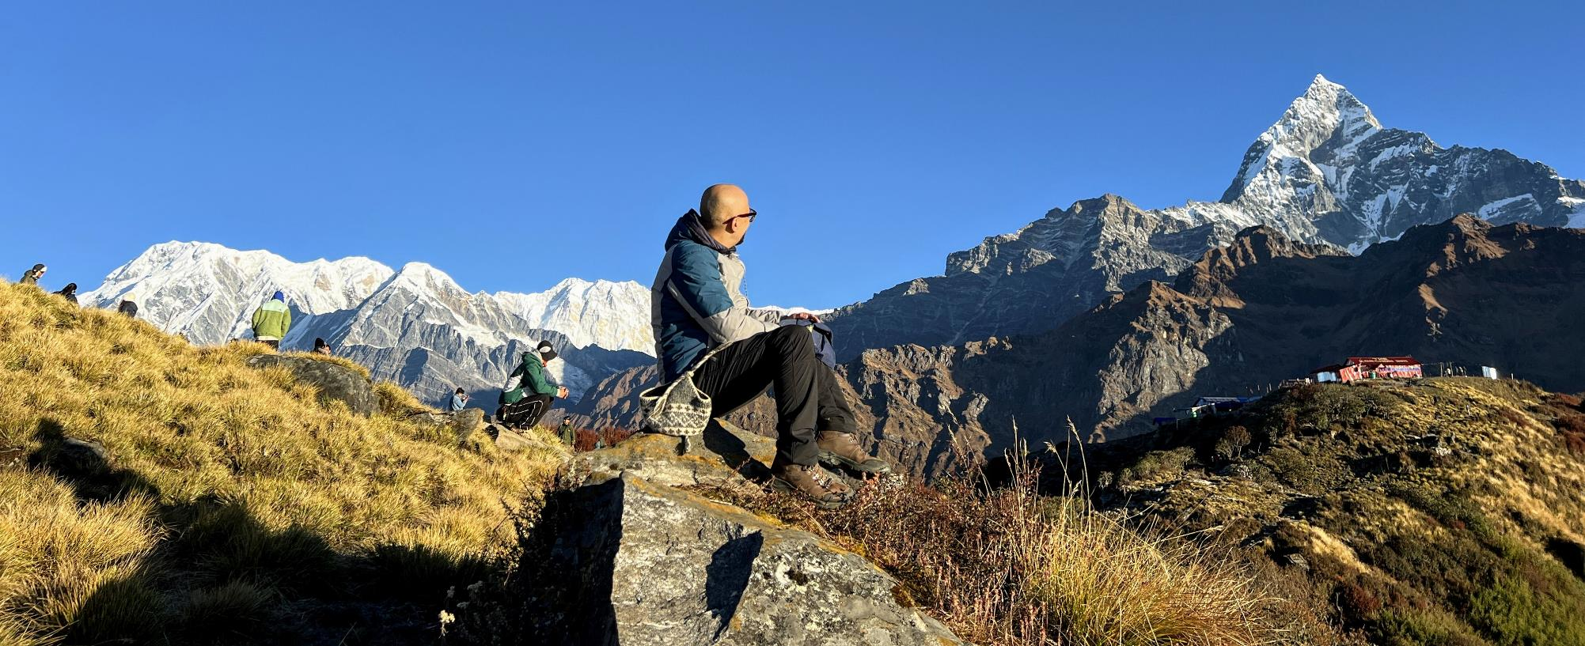
Presented By: Gautam Shrestha
District Secretary 2026-27
District Archive Committee Chair 2026-27
Assistant Governor 2025-26
District Information & Technology Co-Chair 2024-26
District GML & Publication Chair 2024-25
District GML & Publication Co-Chair 2023-24
President Rotary Club of Yala 2022-23
Notes:
To use this title animation slide with a new image simply 1) move the top semi-transparent shape to the side, 2) delete placeholder image,
3) click on the picture icon to add a new picture, 4) Move semi-transparent shape back to original position, 5) Update text on slide.

