Slide 1




Rotary Program for Young Leaders
The Youth Catalyst: Empowering the Next Gen
RTN. AMIT GIRI
District Governor Nominee Designate, 2025’26
• Chair, District Public Image Committee 2024/26 | CEO, ICA @ IGNOU
• President, Rotary Club Rajdhani 2018/19 | RYLA Chair, 2020/21
• Assistant Governor, 2021/22 | District Secretary, 2022/23
• District ICM Chair, 2023/24 | Member, District Learning Facilitation. 2024/26

Slide 2
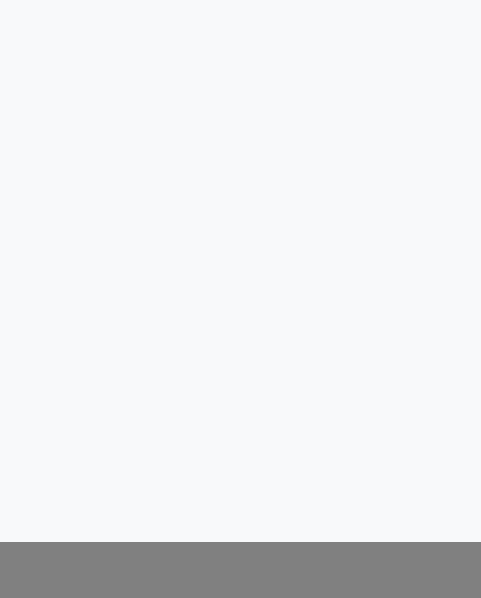


We are excellent at "Uniting for Good."
But to truly "Create Lasting Impact," we must look at who will be carrying our torch in 10 years.
THE REALITY CHECK
"If a brilliant 25-year-old professional walked into your club meeting tomorrow, what exactly would make them want to stay?"
यदि भोलि तपाईँको क्लबको मिटिङमा एक प्रतिभावान २५-वर्षीय पेसाकर्मी आयो भने, ठ्याक्कै कुन कुराले उसलाई त्यहाँ टिकिरहन प्रभावित गर्ला?

Slide 3






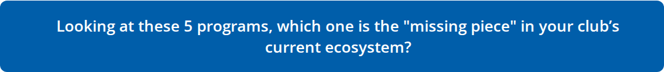
THE 5 PILLARS OF GROWTH
Interact & Rotaract
RYE & NGSE
RYLA
Building community and professional leadership from the ground up.
Interact: 12–18 years Rotaract: 18 and older School/University or Community Based
Fostering cultural and professional exchange on a global scale.
RYE: 15–19 years
NGSE: 18–30 years NGSE has maximum of 6month
Providing intensive, transformative leadership training.

Slide 4


THE "ROI" OF YOUTH
Moving beyond the "Sponsorship" mindset. Young professionals possess the digital fluency, fresh networks, and energy your club needs to survive.
"What if your sponsored Rotaract club mentored your Rotary board on modern digital outreach and attracting younger members?"
We don't just need your funding.
You don't just sponsor us; you need us.
Embrace "Reverse Mentoring".

Slide 5


THE GRADUATION CLIFF
We pour resources into youth programs, yet thousands of trained leaders disappear from the Rotary family.
Are we losing our best investments because we expect young professionals to adapt to outdated traditions, rather than adapting the club to modern professionals?
"Why do you think the vast majority of Rotaractors never transition into a Rotary Club? Is your club's environment currently ready to absorb a young Rotaractor?"

Slide 6


CO-CREATION VS. DELEGATION
Often, Rotary provides the money, and Rotaract provides the free labor. That is not a partnership.
THE OPEN QUESTION
"How can we design a signature project this year where Rotarians and Rotaractors sit at the same table as equal decision-makers?"
Look at your draft budget for next year.
Does it reflect a club that is investing in the future, or maintaining the status quo?

Slide 7

help_outline
"If your club disappeared tomorrow, would the youth in your community feel the void in their leadership journey?"
What is the one legacy you want to leave behind on June 30th, 2027?
यदि भोलि तपाईँको क्लब बन्द भयो भने, के तपाईँको समुदायका युवाहरूले आफ्नो नेतृत्व यात्रामा त्यो अभाव महसुस गर्लान्?
जुन ३०, २०२७ मा तपाईँले छोडेर जान चाहेको त्यो एउटा विरासत (Legacy) के हो?

Slide 8
"To create lasting impact, we must unite our experience with their energy. Let's make it happen this year."
Let's Build the Bridge.
RTN. AMIT GIRI
District Governor Nominee Designate, 2025’26
Chair, District Public Image Committee 2024/26
CEO, ICA @ IGNOU
President, Rotary Club Rajdhani 2018/19
RYLA Chair, 2020/21
Assistant Governor, 2021/22
District Secretary, 2022/23
District ICM Chair, 2023/24
Member, District Learning Facilitation. 2024/26

