Slide 1
Attracting and Engaging Members
Rtn. Dr. Dhruba Pd. Acharya
Co-Chair, District Learning Facilitators Team

Slide 2

Identify and understand ways to attract new members
Create strategies to engage members
Learning Objectives

Slide 3
A. Attracting New Members

Slide 4
Attracting New Members is essential for Rotary Club’s future

Slide 5
Why Attracting New Members Matter:
Membership is the foundation of Rotary Without members, there is no Rotary impact.
More members = greater impact Larger membership strengthens our ability to serve communities locally and globally.
Fresh members bring fresh energy New ideas, perspectives, and skills keep clubs dynamic, relevant, and vibrant.

Slide 6

Science of Attraction
We like people like us (Similarity)
We get attracted to (positive and beautiful)
We get pulled to people and groups if we feel Respected, Inspired, and Included (Emotional Rewards)
Humans are strongly motivated by purpose beyond self (Meaning and purpose)
We are attracted to groups that enhance our identity (Status and identity)

Slide 7
What attracted you to Rotary?
Social service
Networking
Fellowship
Leadership development opportunity
Giving back to the society
Business promotion

Slide 8
What kind of person do you want to attract to your club ?
Persons who add energy, values, and future strength
Don’t just look for successful people. Look for people who want to make a difference as a Rotarian.

Slide 9
Steps to attract ideal person
Identify
Inform
Invite
Engage

Slide 10

“If we want to attract new members, we must first become attractive as a club.”
Engaging meetings
Meaningful service projects
Inclusive and welcoming culture
Visible impact in the community

Slide 11

My message to attract new members:
Let your club be attractive (Start with Club Health Check)
“Be visible” –
Enhance public image
Make the best use of Social Media
Give personal touch to friends and professionals.

Slide 12
B. Engaging Members

Slide 13

Why engaging members matters?
Engagement increases retention.
Low engagement leads to low satisfaction.
When satisfaction drops below a certain level, it turns into dissatisfaction.
Dissatisfied members eventually leave.
Members don’t leave suddenly. They leave gradually.
Engagement → Satisfaction → Retention Disengagement → Dissatisfaction → Exit

Slide 14
Group Activity (7 minutes)
Form group of 4-5 members
💬 Discussion Questions:
How can we better engage members in our Rotary clubs?
What three specific actions do you suggest to increase member engagement?

Slide 15

One innovative idea
“Let’s hear one strong idea from each group”

Slide 16
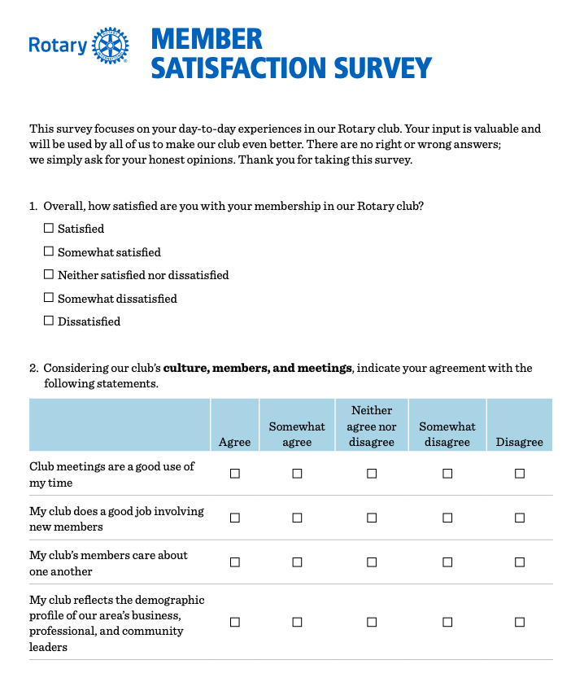
One suggestion to start your presidency:
Carry out Member Satisfaction Survey and implement the outcome

Slide 17
“One action”
“What is the one thing you will do differently during your presidency?”
Share with your friend next to you.

Slide 18
Thank You !

