Slide 1
Planning Your Year /
Goal Setting
Arpana Pradhan Bhandary
President (RY 2023-24)
RC Narayani Mid Town
Member DLFC, Chair Region VI 2025-26
Member DLFC 2026-27

Slide 2
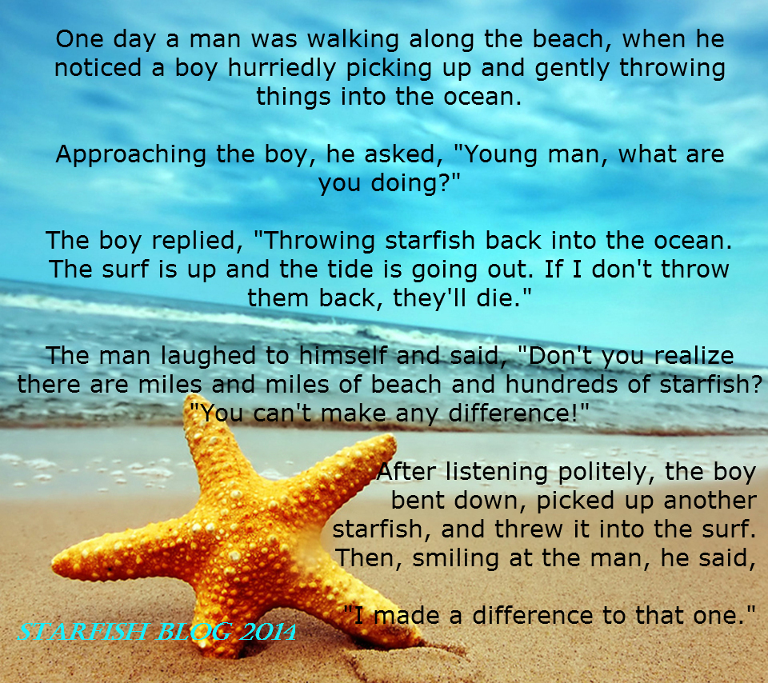

Slide 3
Content of Presentation
Learning Objectives
Rotary Club Central
Rotary’s Learning Center
Reference for Planning your Year
Your Strategic Plan and Action Plan

Slide 4
Learning Objectives
After this session, participants should be able to:
Identify their club’s strengths and weaknesses
Set goals that use the club’s strengths and address the weaknesses (and support District/RI Goals and Club Excellence Award)
Note: All of you have to get ready for the planning of your year and you have to plan now

Slide 5
Club Goals – District Goals
Dental and Oral Health Check Up for 1000 Students
(District Goal 50,000 Students)
Tree plantation: 1000 sapling (District Goal 100,000 saplings)
Distribution of 100 induction heater (District Goal 10,000)
Happy School: Adapt one school (One club one school)
Computer Lab Project (20 in community school)

Slide 6
Rotary Club Central
Enter your goals in Rotary Club Central and review them regularly throughout your term, making adjustments as needed.
Your club goals should align with the Strategic priorities and goals of Rotary’s and your District goals.
Review the status of your goals with members at club assemblies.
Work with your Assistant Governor

Slide 7
Strategic Priorities of RI
PRIORITY 1: Increase Our Impact
As People of Action we make decisions grounded in evidence.
Annual Fund Contributions
Polio Plus Contribution
Service Projects

Slide 8
Strategic Priorities
PRIORITY 2: Expand Our Reach
As People of Action we are inclusive, engaging, compassionate, and ambitious on behalf of the world.
Club membership, Rotaract Clubs, Interact Clubs, RYLA, Media Stories

Slide 9
Strategic Priorities
PRIORITY 3: Enhance Participant Engagement
As People of Action we create meaningful relationships across decades and continents.
Service Participation
Leadership development program
District Conference attendance
Fellowship participation, District training participation

Slide 10
Strategic Priorities
PRIORITY 4: Increase Our Ability to Adapt
As People of Action we seek new perspectives and new ideas that can strengthen Rotary and create lasting change.
Strategic Plan
Online presence
Website and Social Media
Update your Club bylaws

Slide 11
Rotary’s Learning Center
The best thing to plan for Your Year is to take a course in Rotary Learning Center.
For Presidents there is one Learning Plan which comprises of 11 short courses. 15/20 Minutes each
Enter: https://learn.rotary.org/learn/catalog and register to go directly to the Learning Center
Take only one course to start with: Get Ready Club President. The course will greatly help to plan for your year

Slide 12
Rotary’s Learning Center
Download certificate and share with your AG
Take additional courses if you wish at your leisure and complete your Learning Plan
Encourage your Committee Chairs, Secretary and Treasurer to take at least one courses each such as: Get ready Club Admin Committee and so on and suggest them to share their certificates.
Let them complete their Learning Plan at their leisure time.

Slide 13
Reference for Planning Your Year
Get Ready Club President (Manual) ++
District Goals
26/27 Club Excellence Award (Former Rotary Citation)
Strategic Plan of Your Club (existing)
Current Action Plan or Work Plan
Relevant Resources

Slide 14
Reference for Planning Your Year
Review your current year activities in terms of:
What need to be continued as it is
What need to be continued with modification
What need to be dropped because of completion or no relevancy
What new activities to be added (with reference District Goals)

Slide 15
Your Strategy Plan
Steps to prepare your Strategy Plan:
Analyze your clubs current strengths and weaknesses in the (a) Club Administration (b) Membership (c) Service projects (d) Rotary Foundation and (e) Public Relation
Identify external opportunities to improve on the strengths or address the weaknesses?
Identify external challenges that may hinder

Slide 16
Your Strategy Plan
Steps to prepare your Strategy Plan:
Write down the future scenario (say after 3 years) if the strengths are utilized, weaknesses minimized, opportunities cashed, challenges faced
Set 3 years goals for all 5 standing committees to realize the future scenario and corresponding annual goals. (SMART)
Prepare Action Plan or Annual Plan

Slide 17
Action Plan (Committee Wise)
S.No | Annual Goals | Major Actions | Time Schedule | Responsible Main/Support | Remarks/ How will progress be measured?
1 | Goal One | 1.1 1.2 1.3
2 | Goal Two
3 | Goal Three
4 | Goal Four

Slide 18
Goal (SWOC)
S.No | Annual Goals | Strength | Weakness | Opportunity | Challenge
1 | Goal 1: Our club will use its strength in community service to acquire three new members this year | Membership committee members are very active in the community | Our club members don’t engage community service visitors before and after attending an event | Change the mindset of members to engage actively with potential members | Without this change, the club will not appeal to energetic new members.
2 | Goal 2:

Slide 19
Action Plan Worksheet (For Goal 1)
S.No | Action Step | Who will be responsible? | How long will this step take? | How will progress be measured? | What resources are available?
1
2
3

Slide 20


Slide 21
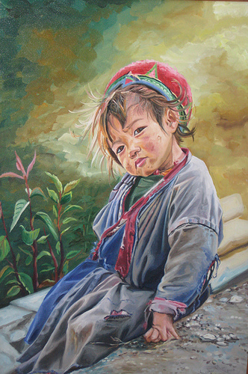
Thank you

