Slide 1


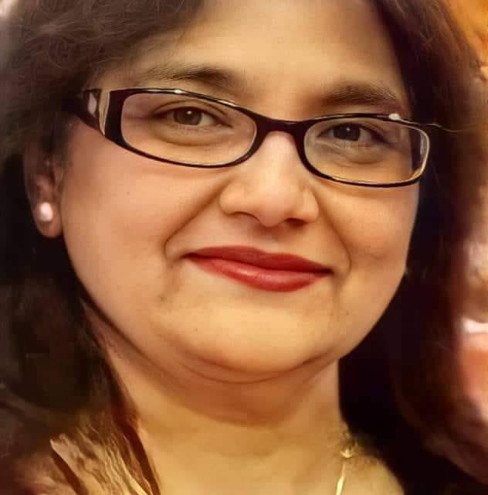
“Service Above Self”
Presidents-elect Learning Seminar
Bhairahawa, Nepal May 1-2, 2026
Rtn. Rama Kandel
Rotary Club of Bagmati Kathmandu
President (2016-17)
RI District 3292
Community Service Chair (2021-23) (2024-25)
District Learning Facilitating Committee, Co-Chair (2025-26)
9851081934| neparunihon@gmail.com

Slide 2

Managing Clubs
Meetings
Reporting Schedule
Dues (Club, District, Magazine & RI)
Governance

Slide 3
MEETINGS IN
ROTARY
Regular Weekly Meeting
Board of Directors Meeting
Club Assembly
Club Committee Meetings
Annual General Meeting

Slide 4
LET’S SHARE
What types of meetings have you attended?
What do you dislike the most?
What’s your dream meeting like?

Slide 5
DO YOU AGREE?
Meetings shape member experience.
Poor meetings reduce attendance.
Great meetings build strong clubs.

Slide 6
KEY
PRINCIPLES
Respect members’ time
Flexible formats (online / offline / hybrid)
Adapt to members’ and club’s needs
Ensure inclusiveness and accessibility

Slide 7
COMMON CHALLENGES
What challenges do you face most often?
Top issues clubs face
Low attendance
Repetitive formats
Lack of engagement
Poor guest experience

Slide 8
INNOVATIVE
MEETING IDEAS
Service-based meetings
Guest speakers and networking
Family-friendly meetings
Short power meetings

Slide 9
ENGAGING
MEMBERS
How do you keep members engaged?
Practical ways to engage
Use member surveys
Rotate roles
Encourage participation
Recognize contributions
Create a welcoming culture

Slide 10
ROLE OF
CLUB PRESIDENT
Plan with the BoD regularly
Ensure meeting quality
Delegate responsibilities
Focus on member satisfaction

Slide 11
TAKE AWAY
What change will you bring to your club meetings?

Slide 12


“Service Above Self”
Thank You
Rtn. Rama Kandel
9851081934| neparunihon@gmail.com

