Slide 1


PUBLIC IMAGE COMMITTEE
ROLES & RESPONSIBILITY
CLLS 2026
30 May, 2026, DAV School, Lalitpur
Chhongba Sherpa
Chair, District Public Image Committee

Slide 2
What we aim to achieve today
Session Objectives
01
02
Core Roles
Responsibilities
Identify Impact Stories
Create Storytelling Content
Share for Visibility
Protect Rotary Brand & Public Trust
Coordinate Media & Partner Outreach

Slide 3
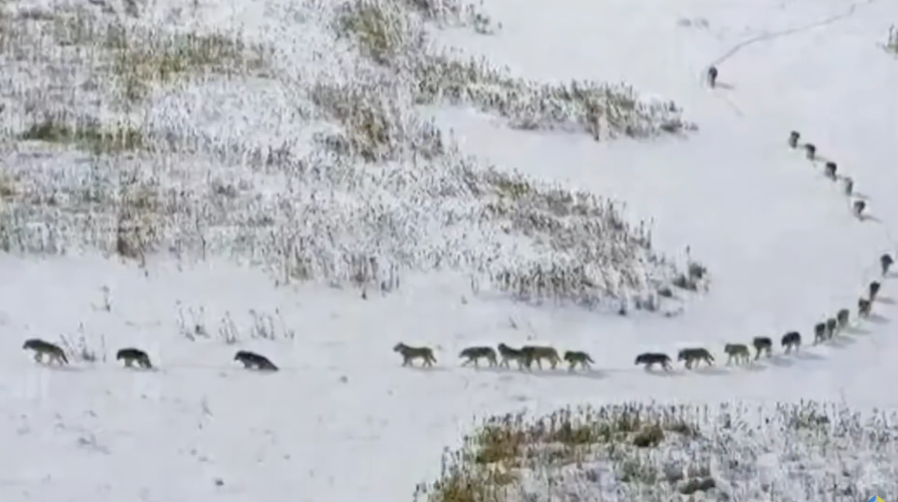

Slide 4

Your Role as Public Image Chair
Manage the club’s external communications, promote its community impact, and maintain strict alignment with Rotary’s global brand identity, while ensuring smooth team coordination and delegation.

Slide 5

WHERE DOES YOUR
CLUB STAND?
☐ Do your club stories regularly highlight beneficiary transformation and impact?
☐ Does your club post impact-focused content at least once a week?
☐ Does your club consistently use the correct Rotary logo, colors, and branding?
☐ Have you accessed the Rotary Brand Center for public image resources?
☐ Have you explored the District portal and public image resources available there?

Slide 6
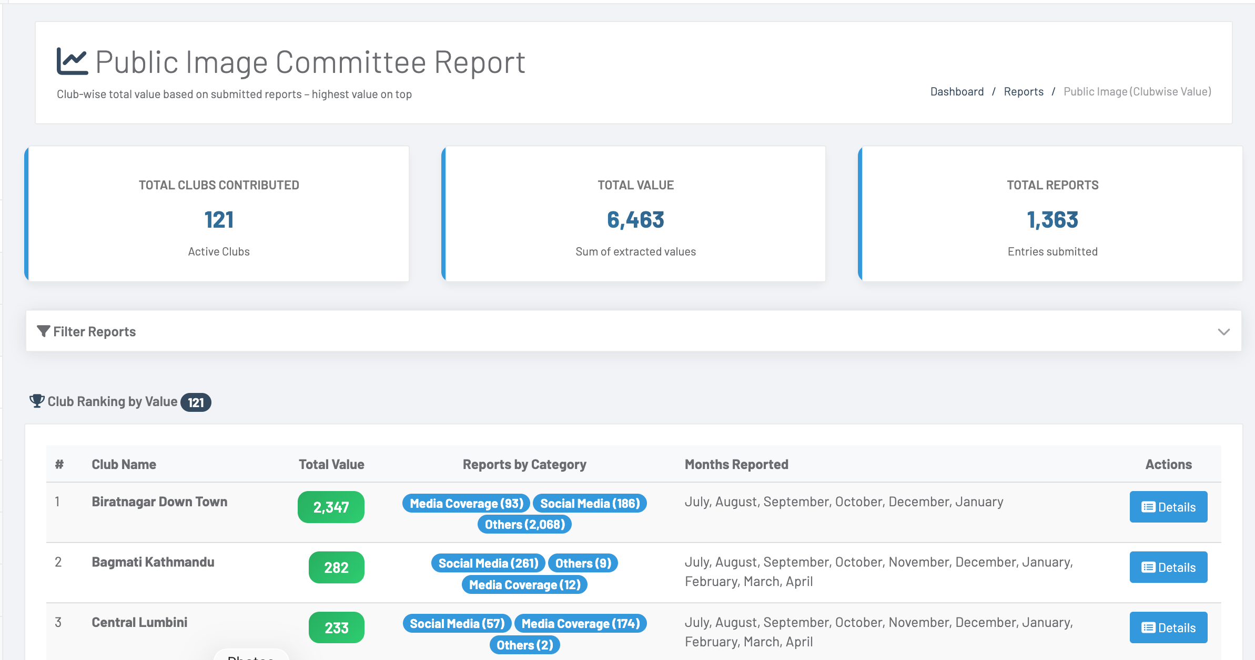

Slide 7
YOUR MASTER LENS
WHO • WHAT • HOW • WHERE • WHEN

Slide 8

WHO
DEFINES ROTARY IMAGE?

Slide 9

People outside Rotary define Rotary’s image in society.

Slide 10
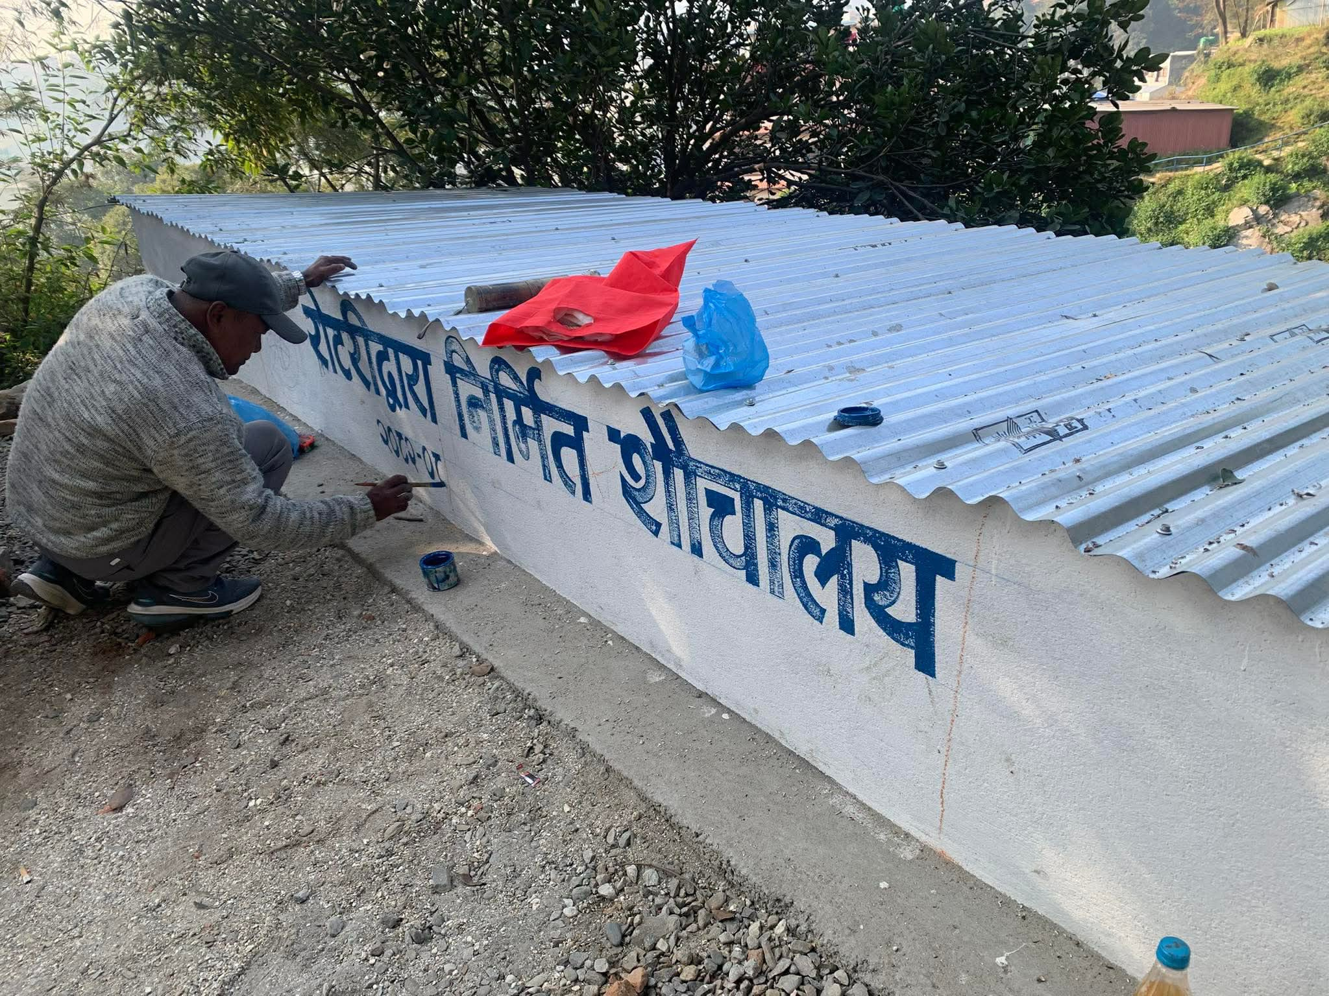
People of Action
Youth & Community Engagement
Beneficiary Voices
Community Transformation
Real Rotary Impact
WHAT should
clubs show?
Show what people care about

Slide 11




SHOW ROTARY
IN ACTION
https://brandcenter.rotary.org/en-us/our-brand/people-of-action

Slide 12
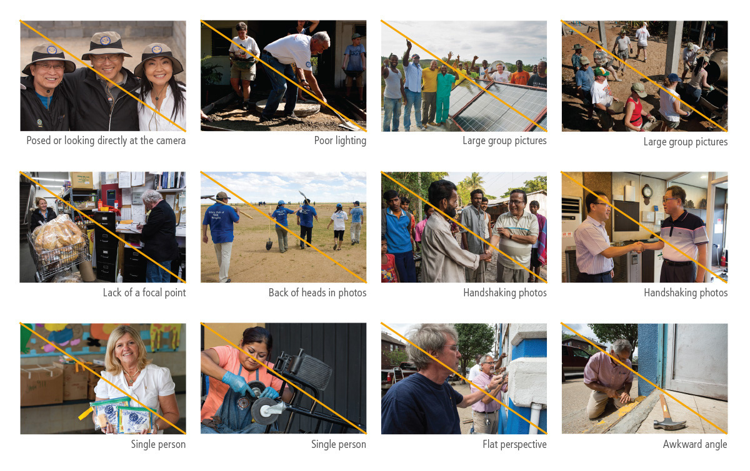

IMAGES
TO AVOID
Photos that focus only on Rotarians, not on impact or beneficiaries

Slide 13
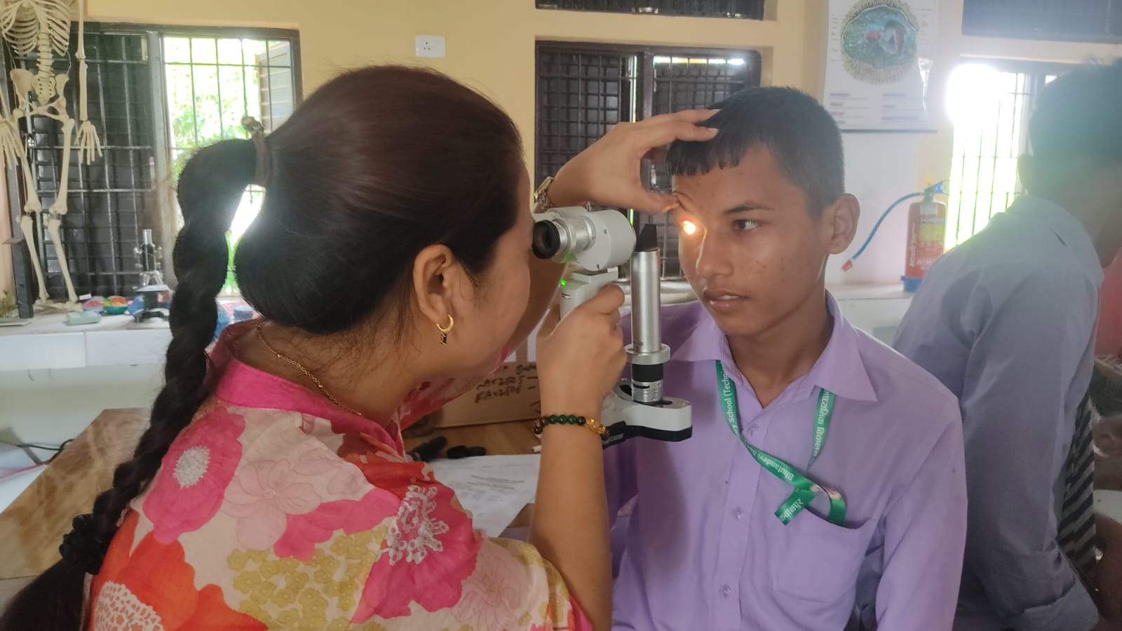
Tell Stories People Feel
Highlight Transformation Stories
Capture Before & After
Involve Volunteers
Record Beneficiary Voices
Use Reels & Short Videos
HOW should
we tell Rotary stories?
Problem → Rotary Action → Human Outcome → Call to Engage
Notes:
The magic formula. Problem → Rotary Action → Human Outcome → Call to Engage. That's it. Four simple steps.

Slide 14

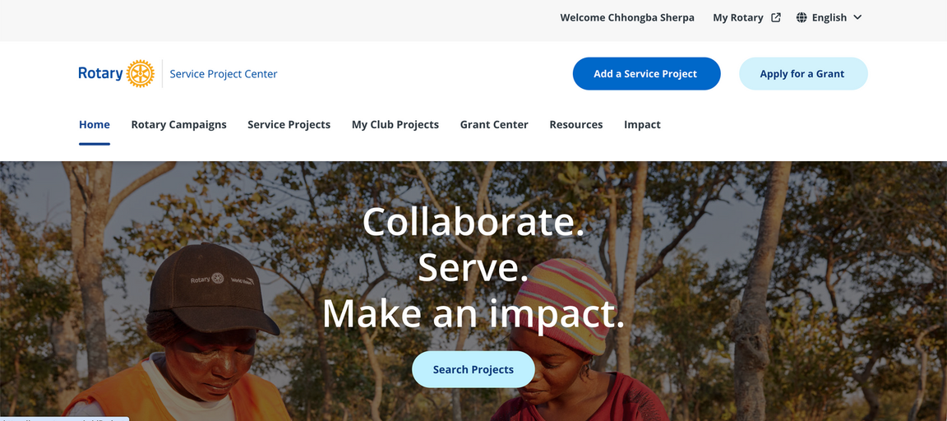
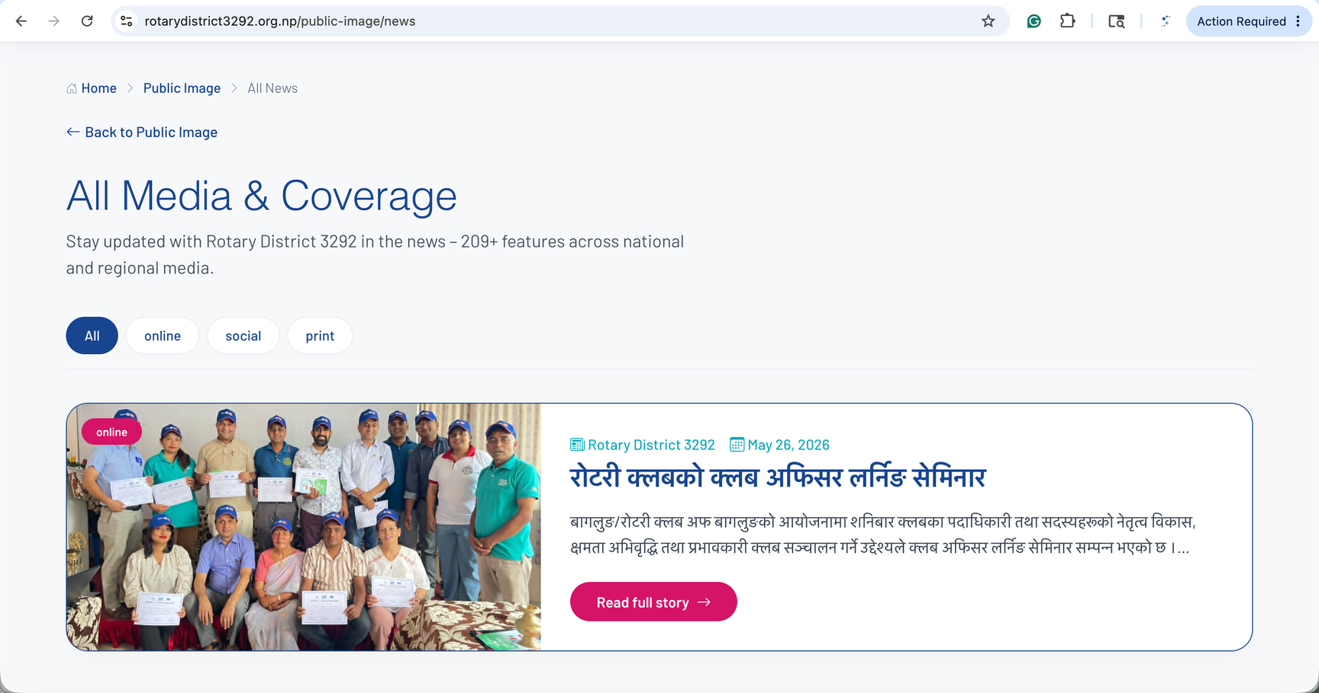
rotarydistrict3292.org.np
WHERE Should We Share Rotary Stories?
Rotary-Owned Platforms
External Media Platforms
Club & District Social Media
Websites (RI, District & Club)
Local Online News Portals
Newspapers, TV & Radio
Notes:
Now, where do we share? Rotary-owned platforms social, websites, district archive. External media on the other — news portals, newspapers, radio, journalists.

Slide 15
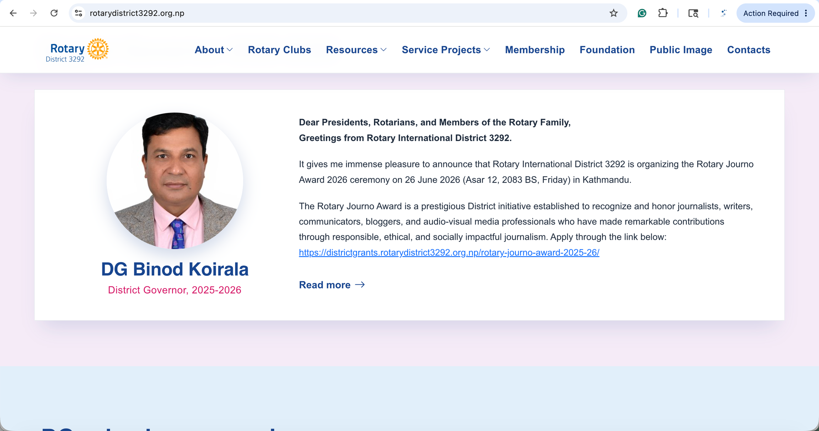
Encourage and Recognize
Public image contributors
Rotary Journo Award recognizes journalists and media professionals for excellence in highlighting Rotary’s humanitarian service and social impact.

Slide 16
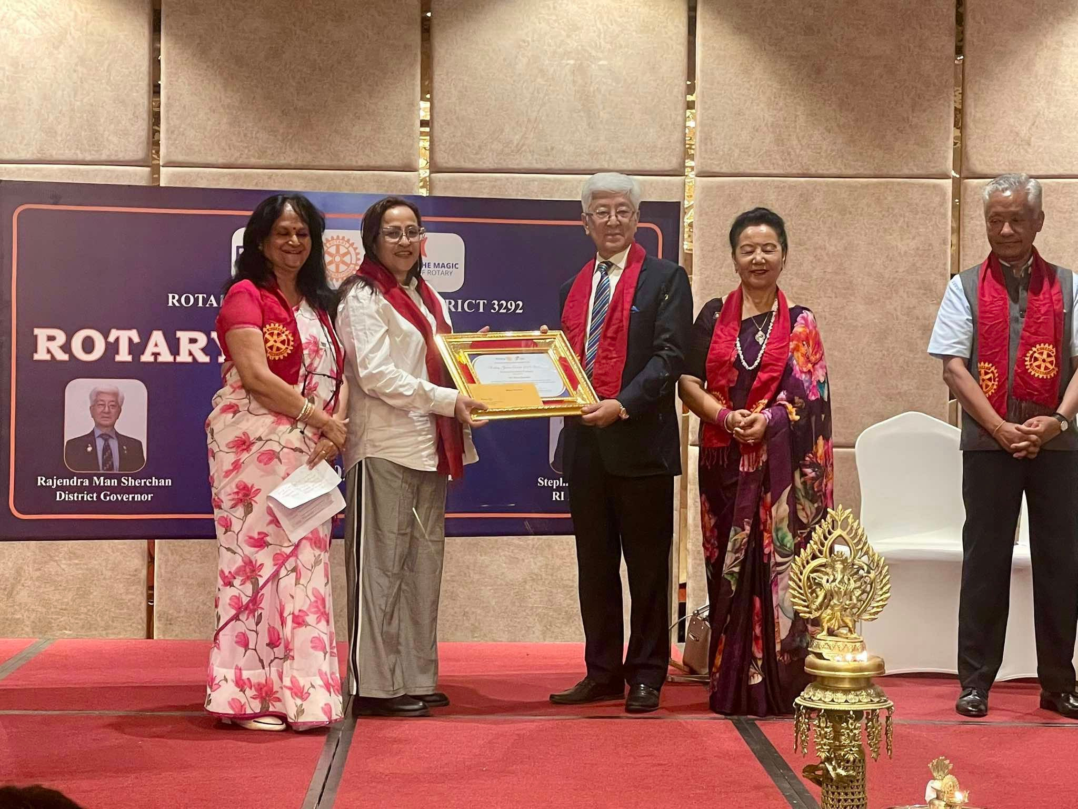
2024-25 Rotary Journo Award

Slide 17
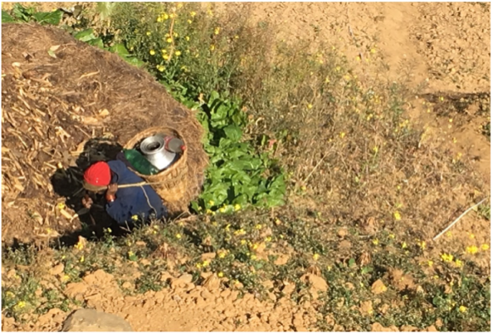
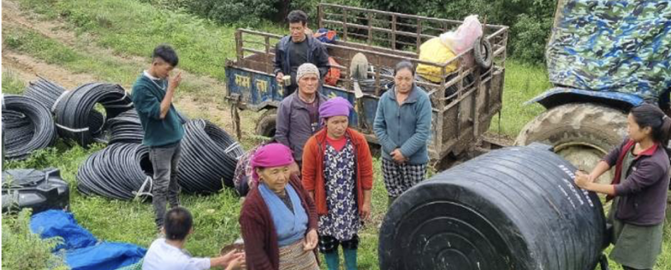
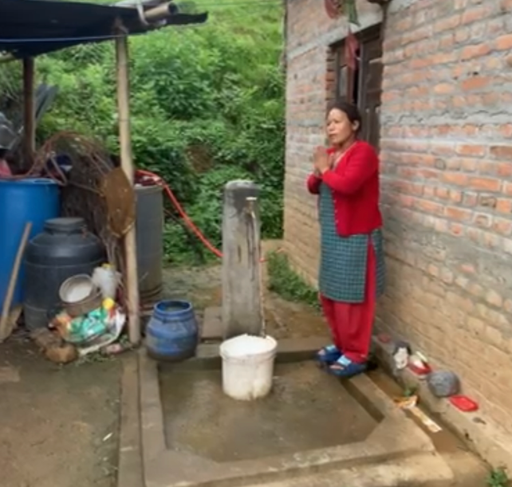
WHEN Should
Public Image Actions Be Taken?
Consistency drives visibility
BEFORE
DURING PROJECT
AFTER
What was
the problem?
What action did
Rotary take?
What changed
in people’s lives?

Slide 18

Maintain Rotary Branding
Our most important responsibility
Use Official Rotary logos only
Follow Approved colours & typography
Maintain Consistency in design
“People of Action” tagline
#PeopleOfAction #RotaryNepal #RotaryDistrict3292 #RotaryClubBoudha
Notes:
This is our most important duty. Brand protection.

Slide 19







Slide 20





Slide 21
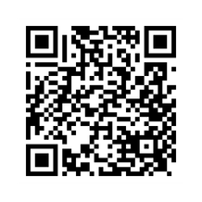


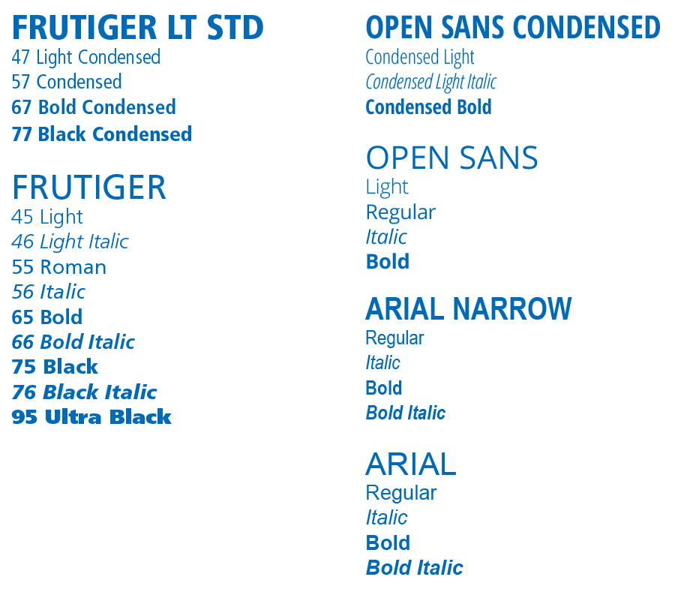
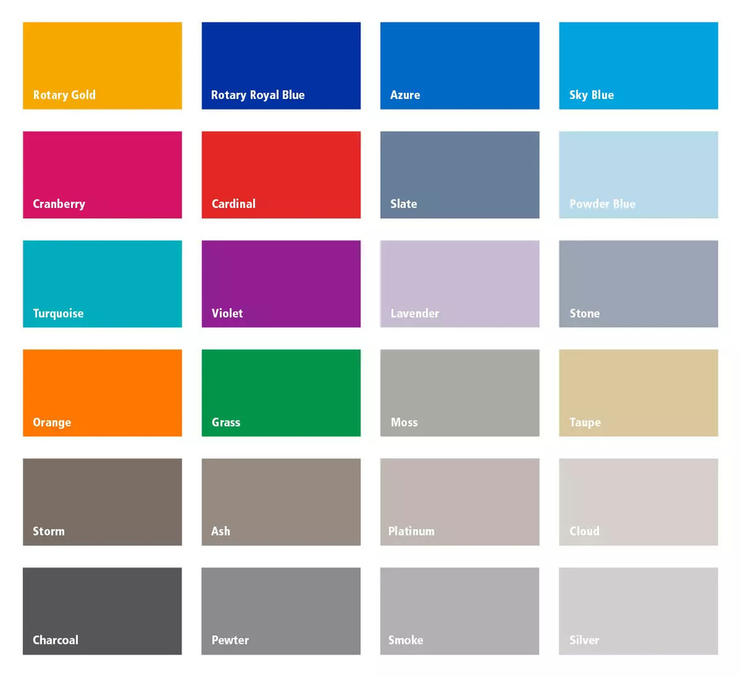

Slide 22

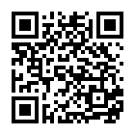

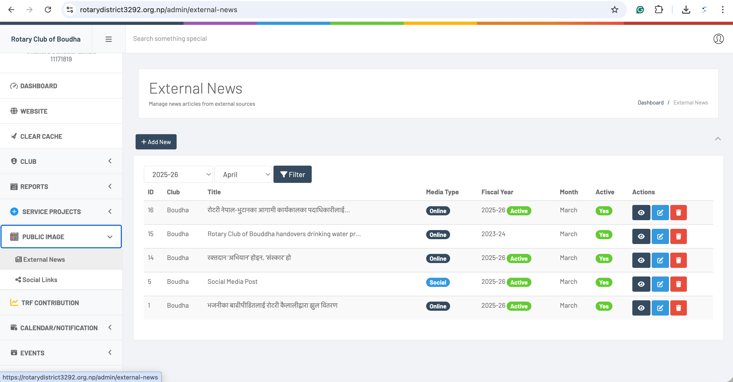
Online Platform
ONE PLATFORM. MAXIMUM IMPACT.
Rotary
News Aggregators
https://rotarydistrict3292.org.np/public-image

Slide 23
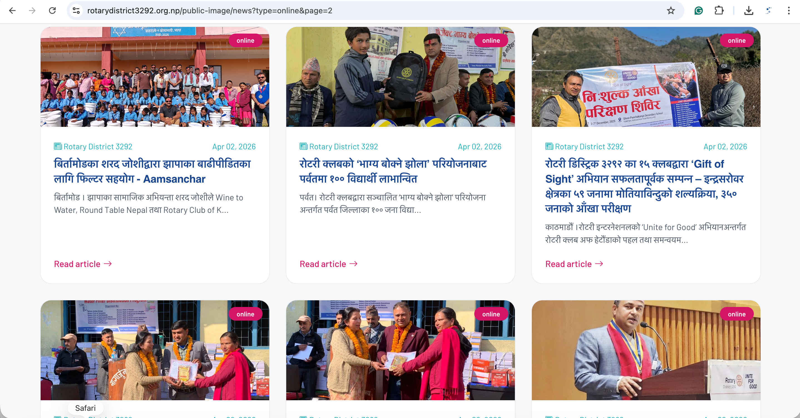
Online Platform
ONE PLATFORM. MAXIMUM IMPACT.
Rotary
News Aggregators
https://rotarydistrict3292.org.np/public-image

Slide 24

Your 2026‑27
Action Plan
Connect with District Public Image Team
Post impact stories regularly
Create
short reels
Strictly follow Rotary branding
We are here to support you.
Always show community change.
Capture before & after, and include real beneficiary and volunteer voices.
Use correct Rotary branding from Rotary Brand Center

Slide 25

Useful resources
https://rotarydistrict3292.org.np/public-image
https://brandcenter.rotary.org/en-us/

Slide 26
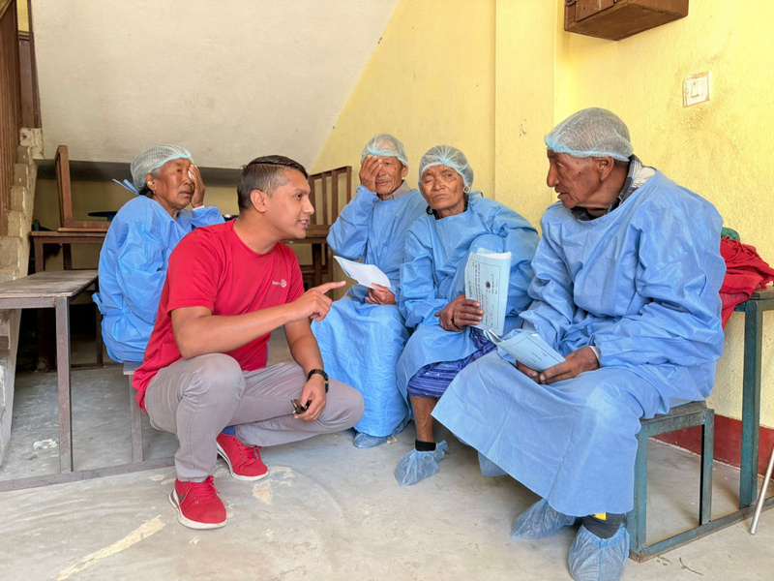

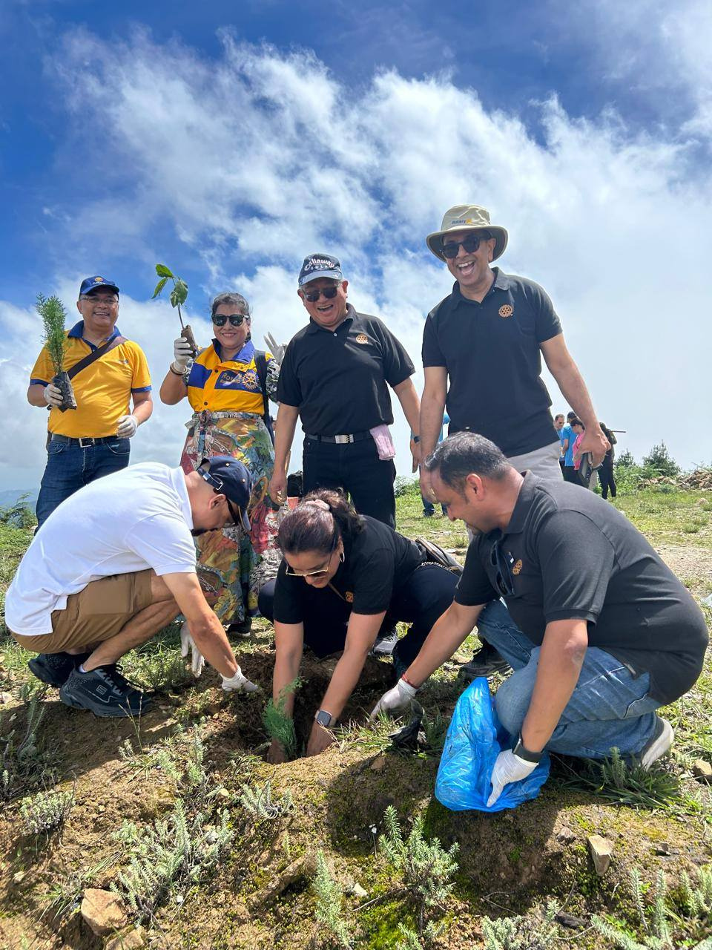
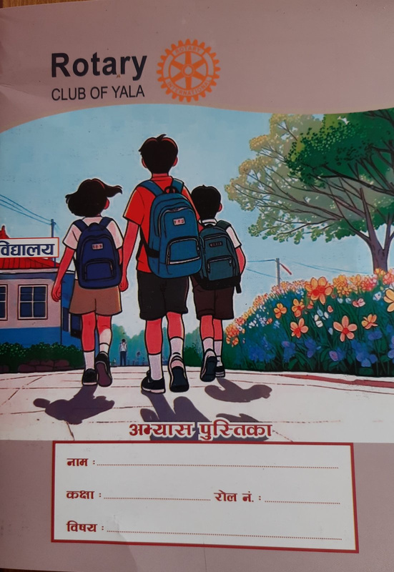
Voice in Action
Every
Rotarian
is Rotary’s Voice
Public Image
brings that voice to the world!
VOICE IN ACTION

Slide 27

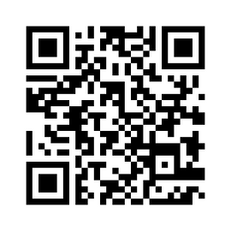



THANK YOU
best wishes for your tenure ahead!
Rtn. Chhongba Sherpa
Chair, District Publict Image Committee (2026-2027)
Charter President - Rotary Club of Boudha
sherparotary@gmail.com
rotarydistrict3292.org.np
+977 9841595911

