Slide 1

Rotary International District 3292
Grant Management Seminar
29 May 2026
Applying for and I
Applying for and implementing a grant
Implementing a Grant
Rtn. Rajendra Lamsal
Member of the Global Grant Review Committee
Cadre, The Rotary Foundation

Slide 2

LEARNING OBJECTIVES
Ability to write a successful grant application
Understand grant financing
Discuss the importance of evaluation

Slide 3
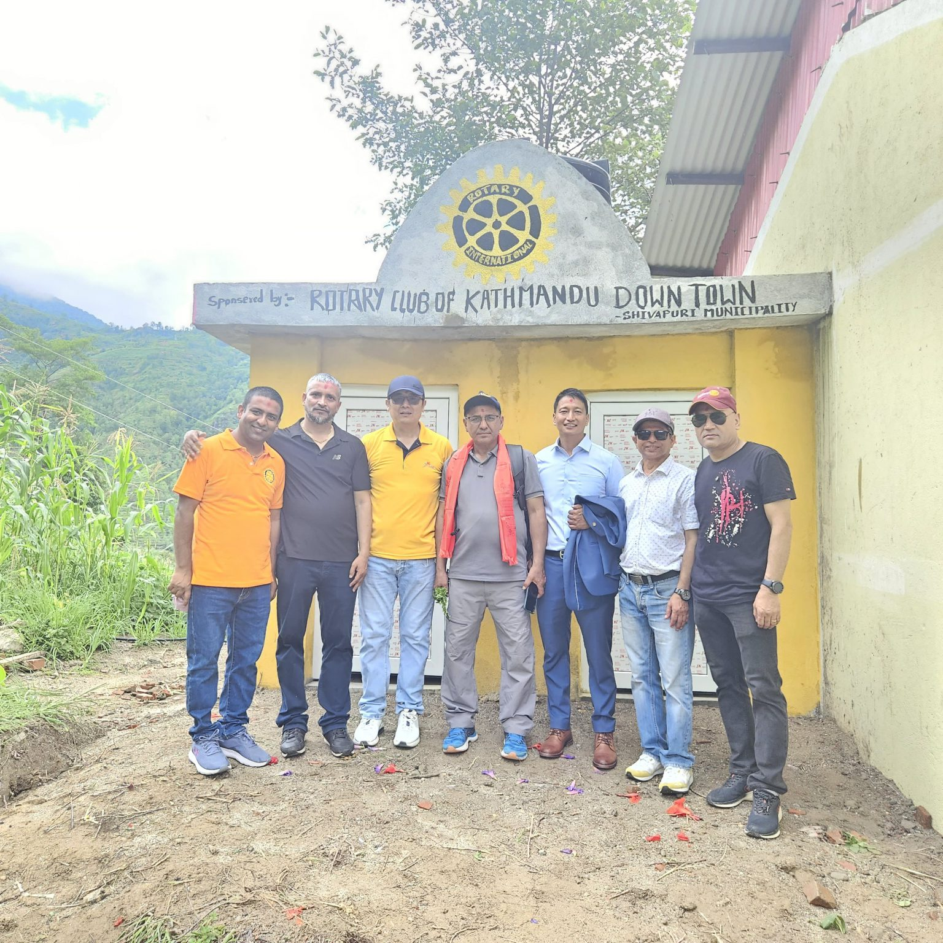
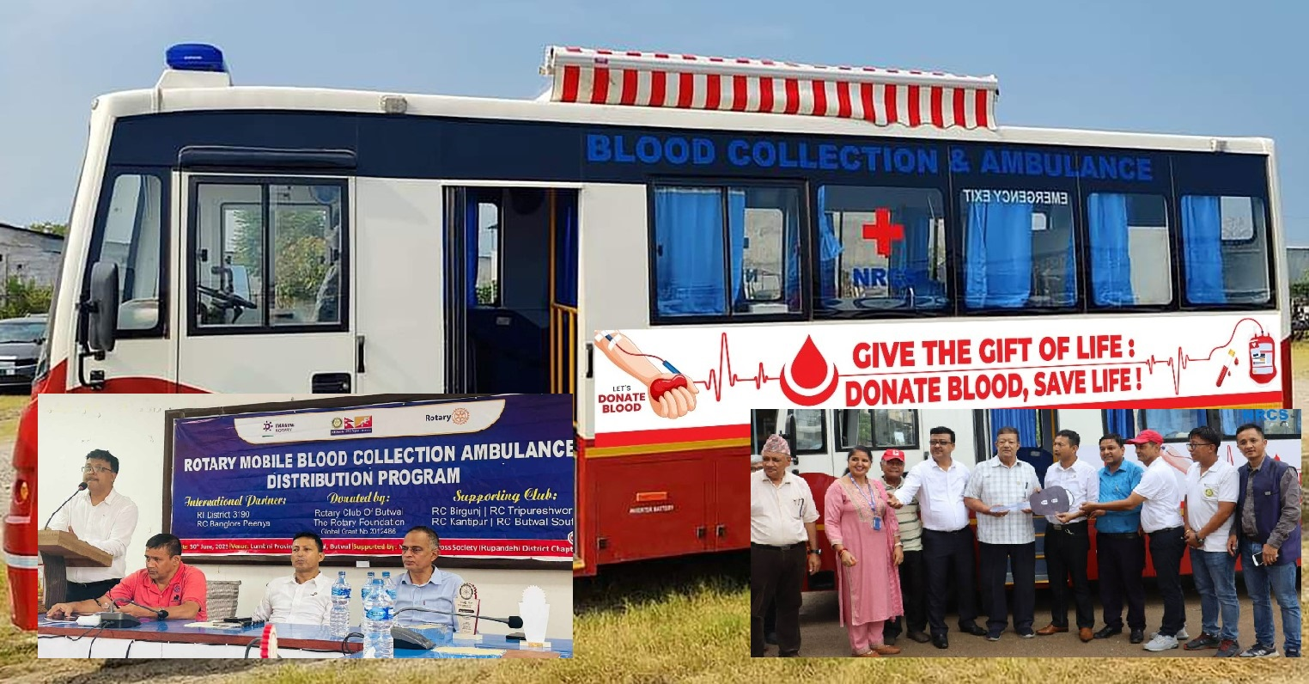
ROTARY FOUNDATION GRANTS
District grants
Global grants
Notes:
Speaking points:
Although this session will focus on applying for global grants, the grant management practices discussed can be used for all grant types.
There are three types of Rotary grants available: district, global, and packaged.
For a district grant, clubs apply to the district, following guidelines developed by the district and the Trustees of the Foundation.
For global grants, clubs apply to The Rotary Foundation, following guidelines developed by the Trustees of the Foundation.
For packaged grants, clubs apply to The Rotary Foundation, following guidelines developed by its Trustees and the strategic partner.

Slide 4
APPLYING FOR GLOBAL GRANTS
Online application process
Meet goals of area of focus
Be sustainable
Involve Rotary clubs in two districts
Minimum total budget of US$30,000
District confirms club is qualified
Notes:
Speaking points:
Rotary clubs (as well as districts) can apply to Rotary for a global grant.
Global grant requests can be submitted online at any time on www.rotary.org.
To be eligible to receive a global grant, a project or activity must
Support at least one area of focus and meet at least one of that area’s goals
Be sustainable
Involve Rotary clubs in two districts in two countries (one in the project country and one in another country)
Have a minimum total budget of US$30,000
The district must confirm that a club is qualified to receive a global grant.

Slide 5
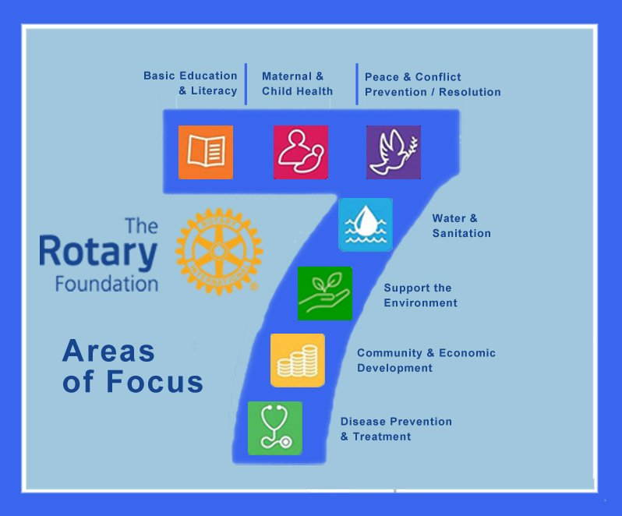

AREAS OF FOCUS
Peace and conflict prevention/resolution
Disease prevention and treatment
Water and sanitation
Maternal and child health
Basic education and literacy
Economic and community development
Notes:
Speaking point:
Each area of focus has specific goals that should be used to refine projects that are developed to meet real community needs.

Slide 6
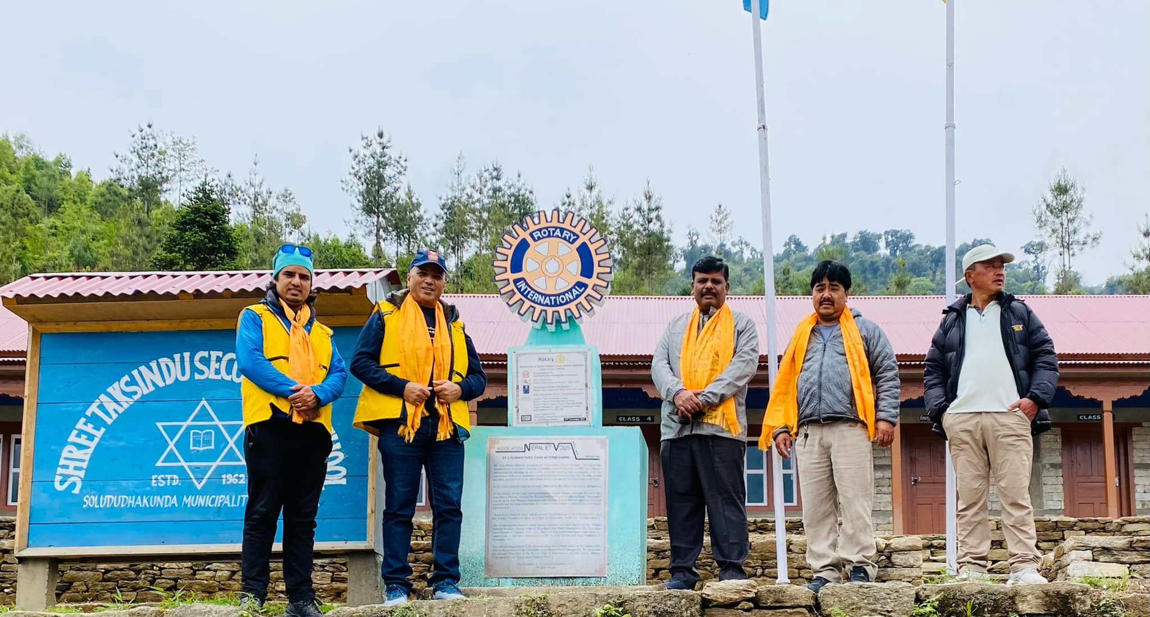
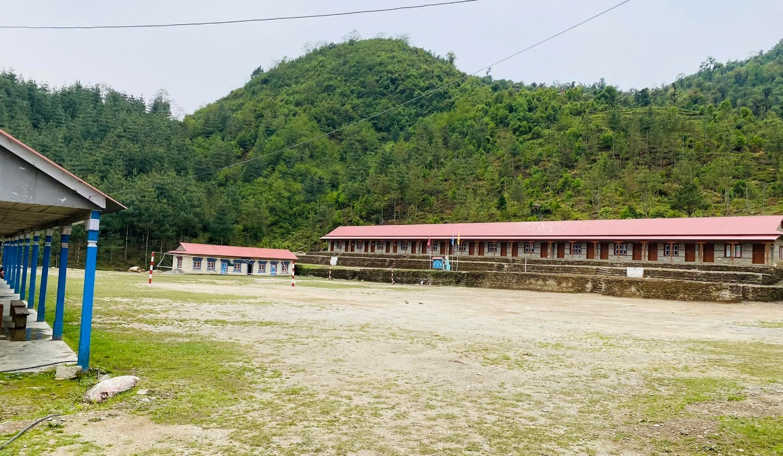
SUSTAINABLE PROJECTS
Giving a community the skills and knowledge to maintain project outcomes for the long term, after grant funds have been expended.
Reconstruction of 12 Classrooms at Taksindu Ma. Bi. , Nunthala, Solukhumbu
Notes:
Speaking points:
To be sustainable, a project or activity will continue to have an impact after the funds are expended.
A project must meet a community need that is consistent with the values and culture of the project’s beneficiaries.
Equipment and technology for a project should be purchased from local sources whenever possible. Spare parts for equipment should be available within the community. Community members should be involved in selecting the equipment and should be trained to maintain and repair it, and a local funding source should cover long-term operation, maintenance, and repair.
A project should strengthen beneficiaries’ knowledge and skills through education and training.
Project partners should collaborate with local organizations to supply expertise.
Project partners should identify individuals willing to assume leadership roles for sustaining project outcomes.
Clear and measurable project objectives should be developed and a method for collecting data established. Figures will, ideally, demonstrate change for at least three years.

Slide 7
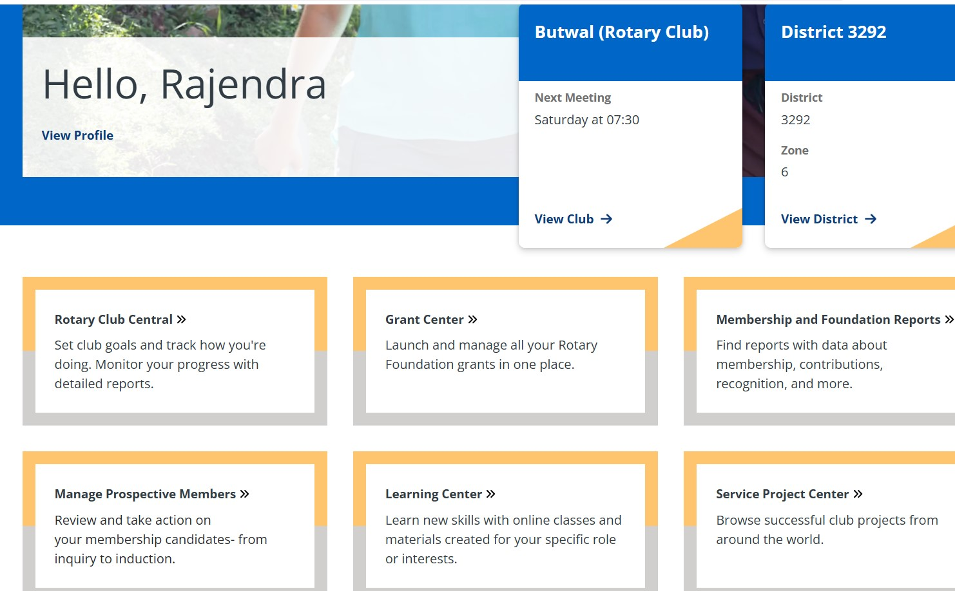
https://my.rotary.org/
Notes:
Speaking points:
Apply for a grant through Rotary’s online application system at www.rotary.org/grants.
To start a grant application, complete the First Steps by hitting the start button. It will give you general information about grant activity and best practices. After navigating through the first steps, you will be able to start your grant application.
Any open global grant applications that have not yet been approved will show up in the Application(s) section. If a grant has been approved and is still open, it will be in Open Grant(s) section. Any grants that have been completed will be in the Closed Grant(s) section.
The Attention Needed section provides alerts if any action is needed on an existing grant.

Slide 8
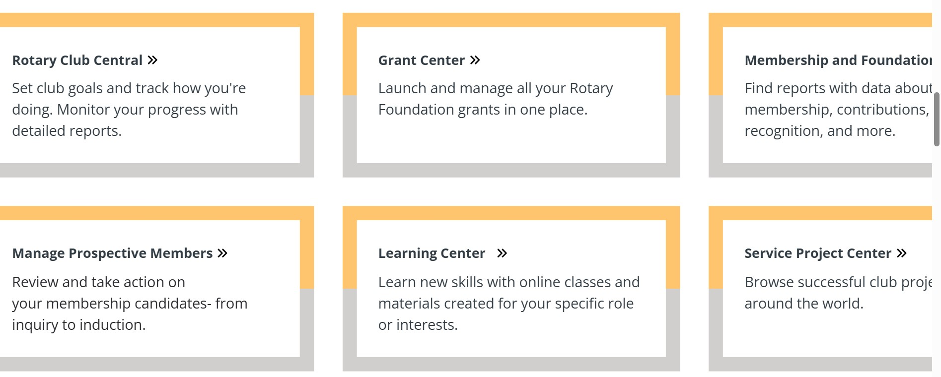

Notes:
Speaking points:
Apply for a grant through Rotary’s online application system at www.rotary.org/grants.
To start a grant application, complete the First Steps by hitting the start button. It will give you general information about grant activity and best practices. After navigating through the first steps, you will be able to start your grant application.
Any open global grant applications that have not yet been approved will show up in the Application(s) section. If a grant has been approved and is still open, it will be in Open Grant(s) section. Any grants that have been completed will be in the Closed Grant(s) section.
The Attention Needed section provides alerts if any action is needed on an existing grant.

Slide 9
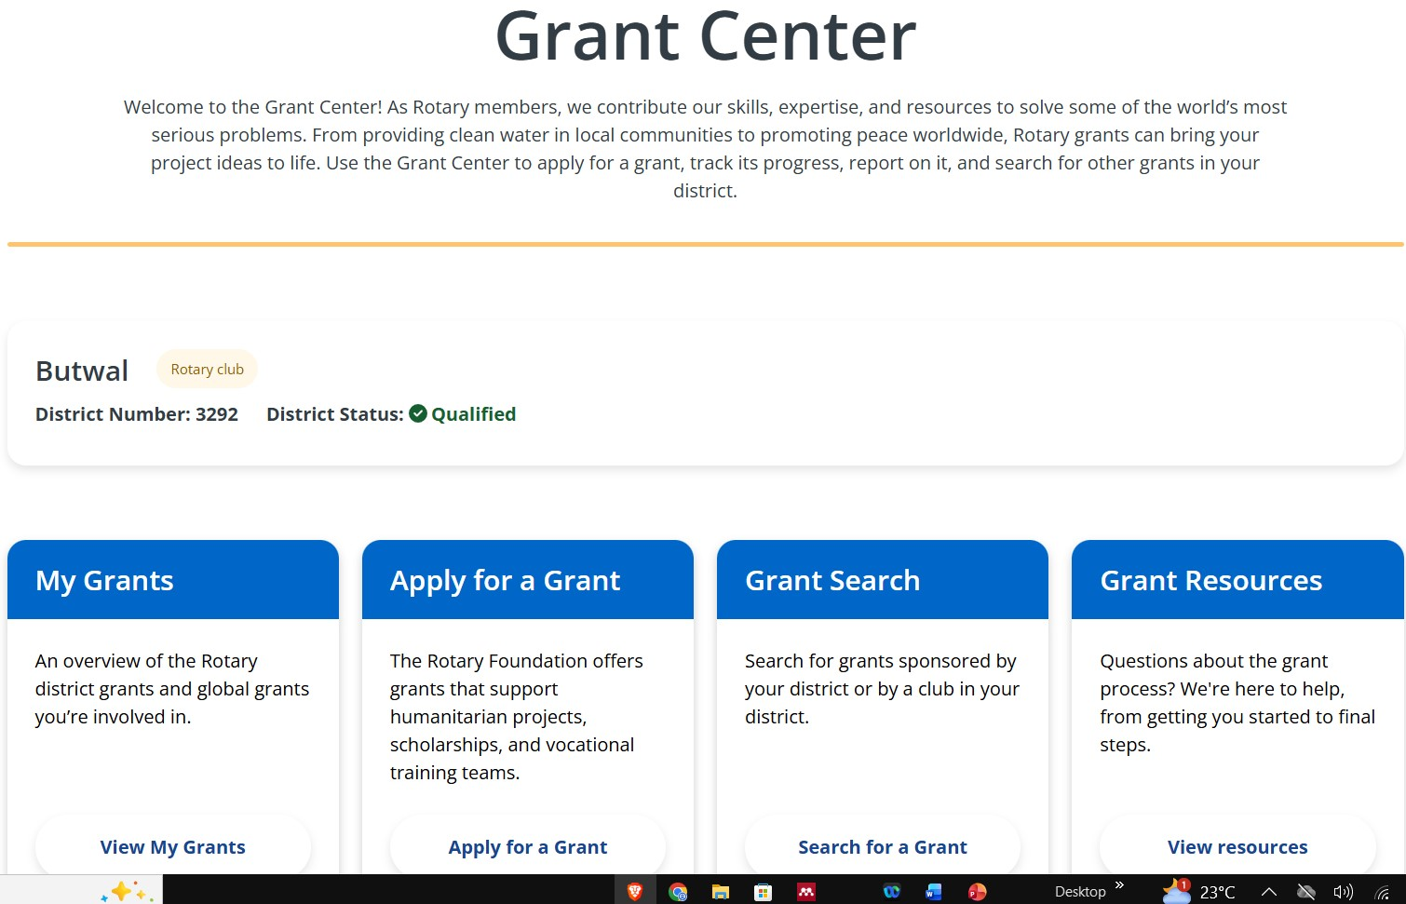


Slide 10
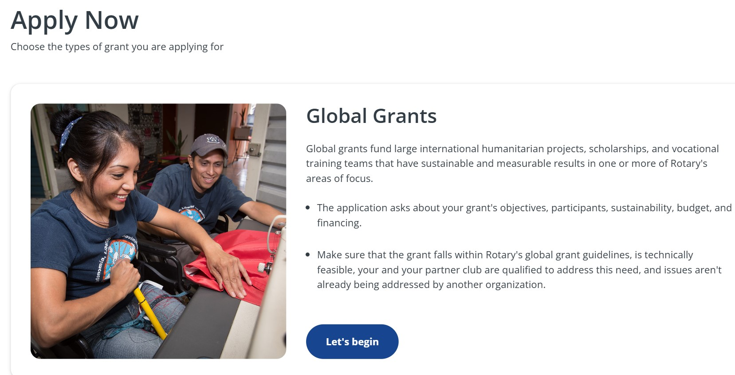

Notes:
Speaking points:
Before starting your application, the primary project contacts from each of the partner clubs must already be designated. And a grant title must be decided upon. This information is required in order to proceed with the application.
Applications must include a detailed project implementation plan and budget.
If you have questions about the application, contact Rotary staff through a messaging function within the grant application system. This will help you ensure that your application is complete before submitting it.
Depending on the project’s budget and complexity, there may be multiple steps to the grant review process.
Once the grant is approved, the primary contacts from the partner clubs will receive formal notification. The club president or district Rotary Foundation chair must authorize the legal agreement to implement the grant.
Discussion question:
What steps should you take before starting the application process? What elements of your project should already be decided or completed?

Slide 11
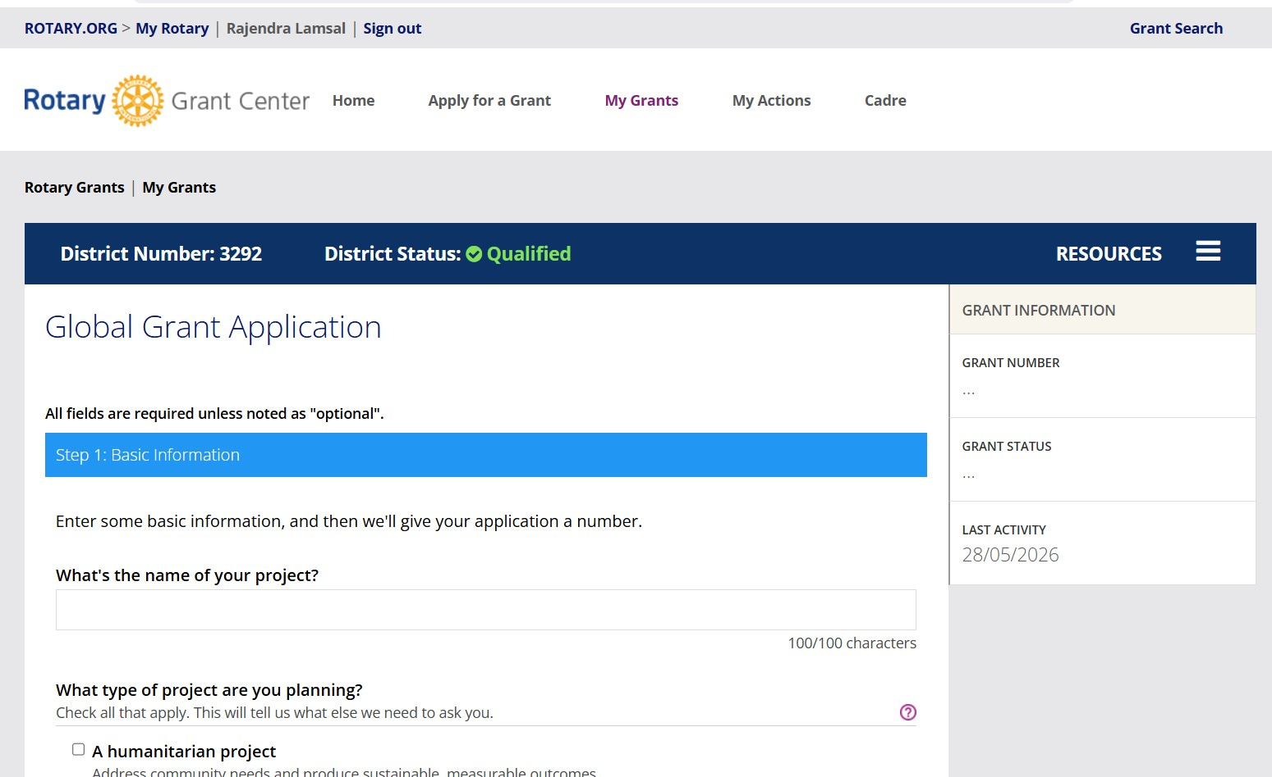

Slide 12
GLOBAL GRANT FINANCING
Minimum budget for a global grant is US$30,000
DDF matched 80% with World Fund
Rotarian and non-Rotarian cash contributions matched
0% with World Fund
Notes:
Speaking points:
The minimum total budget for a global grant project is US$30,000.
Clubs and districts can contribute to the financing of a global grant using:
District Designated Fund (matched dollar for dollar by the Foundation’s World Fund)
Rotarian cash contributions (outright gifts from Rotarians or funds from Rotarian-led fundraisers; matched 50 cents to the dollar by the Foundation)
Non-Rotarian cash contributions (donations from other organizations, businesses, or people; matched 50 cents to the dollar by the Foundation)

Slide 13
FINANCING GUIDELINES
International sponsors provide at least 15% of total sponsor funding
Funds cannot be raised from beneficiaries or cooperating organizations in exchange for a grant
Funds cannot come from other grants
Contributions credited to donor
Notes:
Speaking points:
International sponsors of humanitarian projects are required to provide at least 30 percent of the total sponsor funding.
Rotarians cannot collect funds from beneficiaries or cooperating organizations in exchange for receiving the grant.
Contributions cannot come from other Rotary grant projects.
Cash contributions should always be credited to the individuals who gave the funds. Rotarians cannot collect funds from individuals and claim the donation as their own, unless they have received explicit permission from the donors to do so.
International sponsors of humanitarian projects are required to provide at least 30 percent of the total sponsor funding.
Discussion questions:
How do you raise cash contributions for projects?
How do you motivate donors to give more?

Slide 14
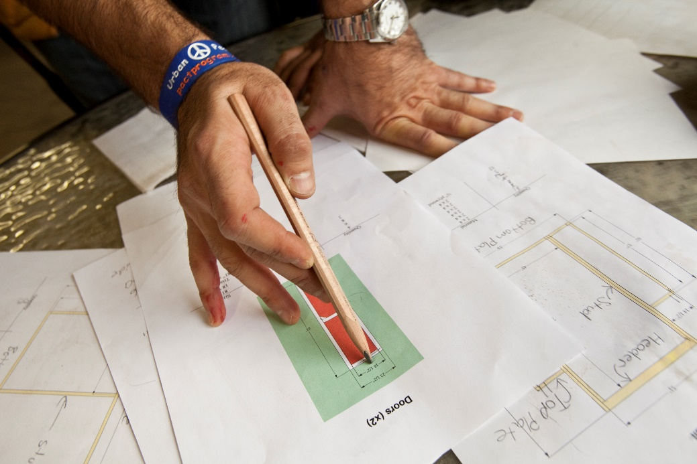
CONFLICT OF INTEREST
Exists when a Rotarian benefits financially or
personally, from a grant
Benefit can be direct to a Rotarian or indirect to an associate of the Rotarian
Notes:
Speaking points:
A conflict of interest exists when a Rotarian may benefit financially or personally from grant activities.
The benefit can be either direct (the Rotarian benefits) or indirect (an associate of the Rotarian benefits).
Financial benefits could include receiving grant funds for being a project manager or receiving grant funds as a vendor for the project.
Personal benefits could include receiving a promotion, getting business referrals, or gaining publicity or improved social standing.
Associates can include family members, friends, other Rotarians, personal acquaintances, colleagues, and business partners.
Rotarians have a reputation for professional integrity. Addressing and preventing conflict of interest helps preserve this reputation for the club, district, and The Rotary Foundation.
When Rotarians freely disclose any direct or indirect association with the grant project, they help ensure fair process and transparency in the use of Foundation funds.
Rotarians must disclose any conflicts of interest on the grant application. If Rotarians aren’t sure whether a particular situation is a conflict of interest, they should talk with their grant officers.
An actual or perceived conflict of interest does not necessarily disqualify a Rotarian from participation in a Rotary grant. Eligibility for participation will be determined case by case upon disclosure of the conflict of interest.
Discussion questions:
What are some examples of conflict of interest?
Why should clubs be concerned about conflicts of interest?

Slide 15
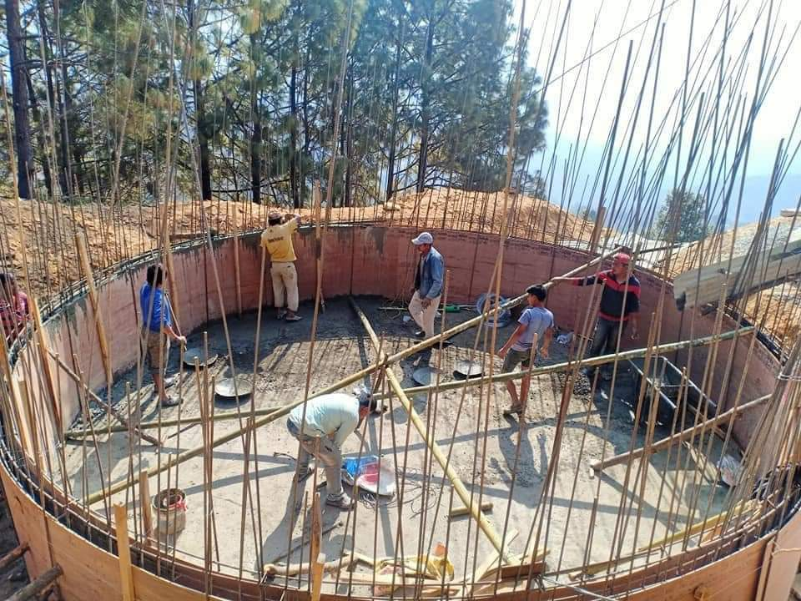
IMPLEMENTATION
Communication
Financial management plan
Record keeping
Following original plan
Notes:
Speaking points:
Communication is crucial to a successful implementation. You should communicate regularly with:
Partners and community members about the progress of the grant
Scholars about the progress of their studies
Both partner clubs and districts to report on how funds are being spent
The Rotary Foundation, according to the reporting requirements of the grant terms and conditions
The club must implement a financial management plan for grant funds, including a separate bank account, a plan to transfer the custody of the account if necessary, a plan to disburse funds, and any requirements related to local laws.
Detailed grant records simplify reporting on the use of grant funds, responding to inquiries, and increasing the transparency of how grant funds are managed.
For global grants, follow the Rotary-approved grant plan. Any changes to the scope or budget of your project requires Rotary’s approval.
Discussion question:
How can a club best keep track of its project’s implementation?

Slide 16
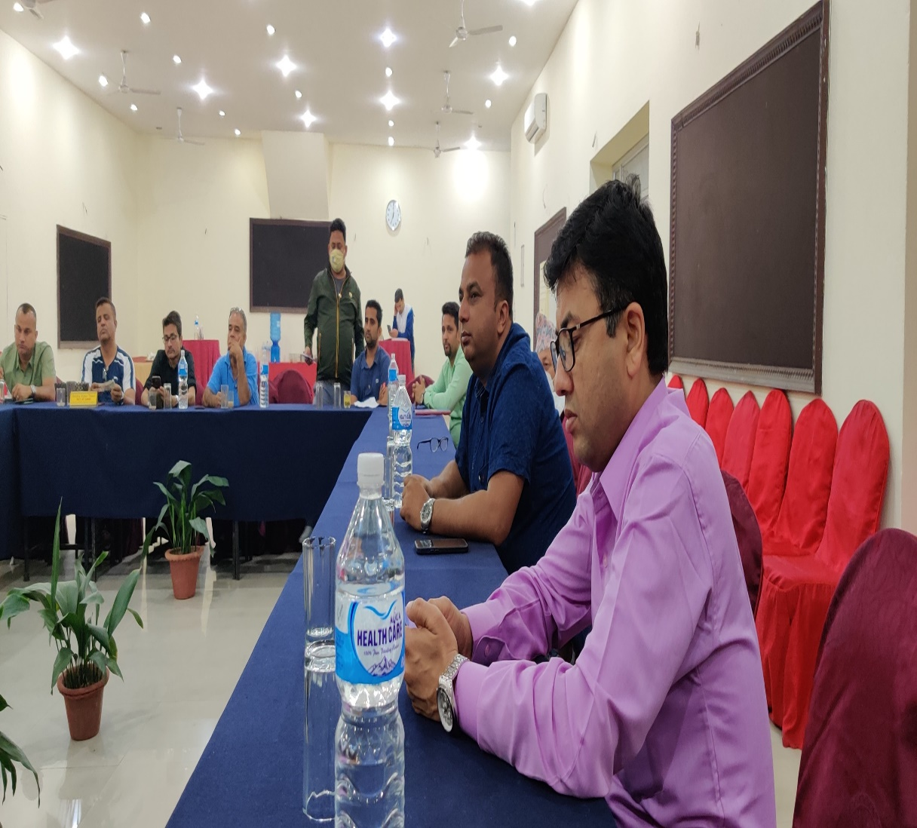
EVALUATION
Assists with
reporting
Improves future
projects
Is based on goals
Is ongoing
Identifies successes
Notes:
Speaking points:
Conducting an evaluation helps a club determine the success of a project and identify any areas of improvement for the future.
Conducting an evaluation will assist clubs with their reporting requirements.
Use lessons learned to replicate successes and adjust for challenges in the next project.
Use the goals set during the planning stage to evaluate the success of a project or activity.
The data and evaluation method and frequency should be set during the planning stage.
Project evaluation happens during implementation through completion and beyond.
Promoting project and activity successes, both within your club and with the public, gets others involved and interested in participating in Rotary, and it’s a great way to let donors know how funds were spent.
Discussion questions:
What are some ways your club can evaluate a project’s success?
Has anyone conducted a grant evaluation? If yes, what did your club learn from it?
What did your club do with the information from the evaluation?
How did your club share the success with Rotarians in your club and district as well as to your community?

Slide 17
Any questions?

