Slide 1
LEADERSHIP
PDG Rtn. CA Jitendra B Rajbhandary
District Learning Facilitator 2025-2026
RI District - 3292
Club Leaders Learning Seminar
DAV School, Dhobighat, Lalitpur
30 May 2026

Slide 2
What is Leadership??

Slide 3
What is Leadership?
Leadership in Rotary has never been about position or authority
True leadership is not about standing above people, but standing with them
Leadership in Rotary is always about responsibility.

Slide 4
Leadership
Leadership in Rotary is taking decisive action for the future
In simpler terms, leadership is focused on future, and the future of Rotary is our primary concern

Slide 5
What does a Club Leader do?
What are important Leadership Skills for your role?

Slide 6
What does a Club Leader do?
As a Club Leader, You lead and motivate your club, ensuring that club members feel valuable, inspired and connected to each other.

Slide 7
Important Leadership Skills
Integrity & Ability to Delegate
Communication & Self Awareness
Gratitude & Learning Agility
Influence & Empathy
Stepping forward during a crisis
Notes:
7

Slide 8
Strategies to be used
What Strategies will you use to keep club members motivated?
Notes:
8

Slide 9
Strategies to be used
Motivating club members, inspiring them, Engaging them
Fostering enthusiasm for projects is one of the most important leadership qualities and a key to success
because only motivated members are inspired members.
Notes:
9

Slide 10
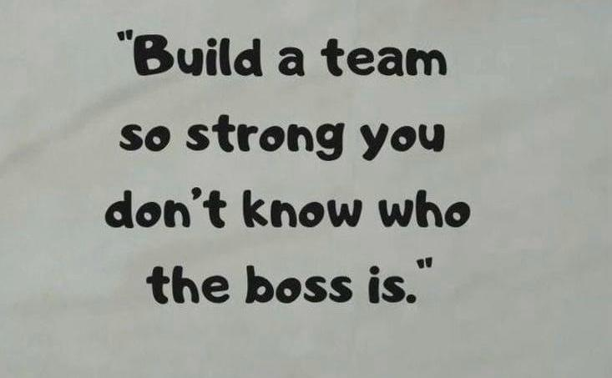
Notes:
10

Slide 11
Working with District Leaders
Get Inputs/ Support/ Guidance
from
Assistant Governors/ District Committee Chairs/ District Secretary
Notes:
11

Slide 12
Working with District Leaders
How do you communicate with District Leaders?
Notes:
12

Slide 13
Possible Issues that could arise
Insufficient sense of urgency
Lack of visible crises
Low expectations
Acceptance of mediocrity
Notes:
So let’s look at these – allowing to much complacency – You need to take back the numbers and facts that you have learned and create urgency – if not Now, WHEN. Some of you have seen the graph line going down – when your club reached below 20, it is difficult to get speakers, to offer quality service projects and folks plain out wonder if they wan to join this group when they visit. If you think you lack a crisis, how many of your clubs make it look easy to recruit the string of Presidents or membership chairs for your club? You do have membership chairs don’t you?
In Rotary we have begun to accept mediocrity – face it , if your club is consistently losing members, it is a mediocre club or one that accepts mediocrity – despite what you do in service or donate to the Rotary Foundation – your club may be just one or two life happenings away from disappearing.

Slide 14
Possible Issues that could arise
Not including influential “thought leaders” from the membership
Getting hijacked by group dynamics vs. early “consensus-building” conversations with key individuals
KEY
Notes:
Let’s move on to that Powerful Guiding Coalition. We will make a list of these shortly –
You need to get a few influential thought leaders and go out to lunch or coffee with them and talk about the numbers and your intentional membership strategies. Enlist their help. Some of these you will need to work carefully – talk about the ideas and when they leave, these ideas will be theirs. Get their buy in before you take these ideas to the board – get your membership chair on board
Don’t get hijacked at a board meeting by someone – the issue of Membership is too important to leave this to chance – get them on board NOW.
If there is someone who is vehemently apposed you need to know this now and defuse them.

Slide 15
Permitting Obstacles to Block the New Vision
Lack of organizational support
(an effective membership committee)
Lack of recognition systems
Lip service (or worse) from influential members
Elder naysayers
Notes:
Typically Rotary clubs act as a one man committee – you can not do this yourself, you need lets say in the case of membership – a membership chair and a membership committee. I have to share that I have met with club boards that say, we are all responsible so we do not have a membership committee – those clubs lost members! You need leaders, pushers, planners, folks who followup. Orientation and installation need to be a big deal – recognize the sponsor

Slide 16
How to remedy the situation?
Establishing a sense of urgency
Creating the guiding coalition
Developing a Vision and Strategy
Communicating the changed Vision
Empowering (expecting) a broad base of members to take action
Generating short-term wins
Notes:
Here are the six steps again – they are on the inside cover of your Leading Change WorkBook

Slide 17
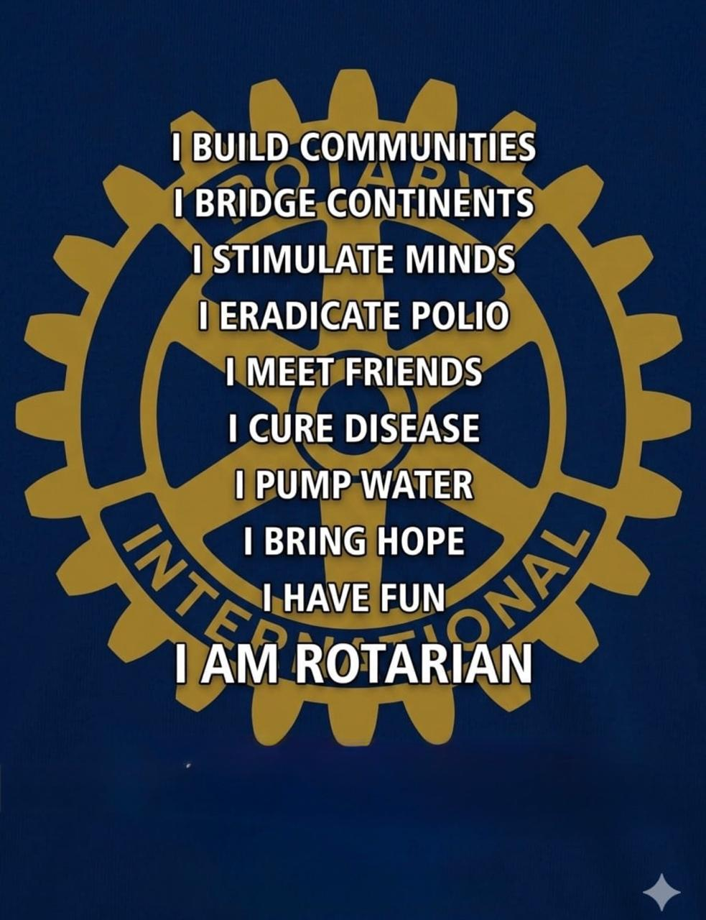
Notes:
Here are the six steps again – they are on the inside cover of your Leading Change WorkBook

Slide 18
Leadership
THANK YOU

