Slide 1


ROTARY INTERNATIONAL
Club Leadership Learning Seminar (CLLS)
PUBLIC IMAGE
DEVELOP GOALS
A 45-Minute Interactive Session for Club Leaders
⏱ 45 MINUTES
🎯 INTERACTIVE

Slide 2






SESSION ROADMAP
What We'll Cover in 45 Minutes
The Wake-Up Call
0–5 min
Hook + Why public image matters NOW
Understand the Landscape
5–15 min
What is public image? Key pillars & Rotary's vision
Develop Your Goals
15–30 min
Framework + Group activity to build SMART public image goals
Action Planning
30–40 min
Tools, channels & quick wins for your club
Commit & Close
40–45 min
Individual commitment card + Q&A

Slide 3
ROTARY INTERNATIONAL
Club Leadership Learning Seminar (CLLS)
6th August, 1945
8:20 (AM)

Slide 4
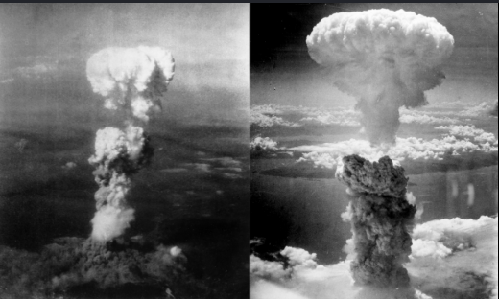
ROTARY INTERNATIONAL
Club Leadership Learning Seminar (CLLS)
“A mushroom cloud rise moments after the atomic bomb was dropped on the Japanese city of Nagasaki on Aug 9,1945.
Three days after the U.S dropped an atomic bomb on Hiroshima”

Slide 5
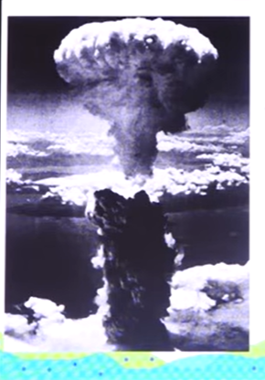
ROTARY INTERNATIONAL
Club Leadership Learning Seminar (CLLS)
“Within the first two to four months of the bombings, the acute effects killed 90,000-1,66,000 people in Hiroshima and 60,000-80,000 in Nagasaki”
Roughly half of the deaths in each city occurring on the first day.

Slide 6
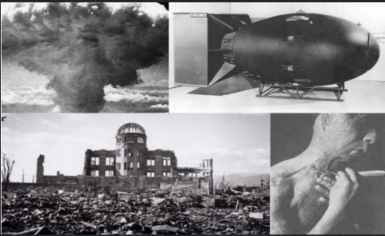
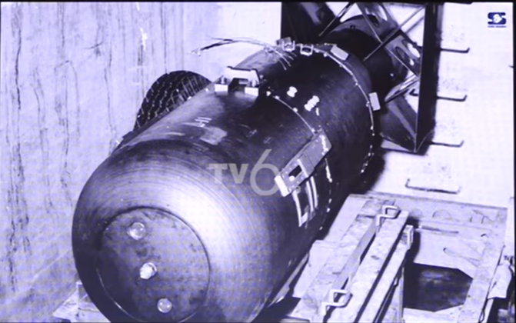
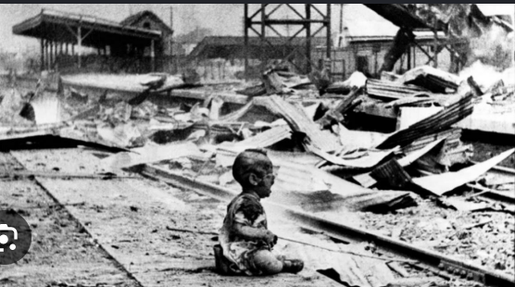
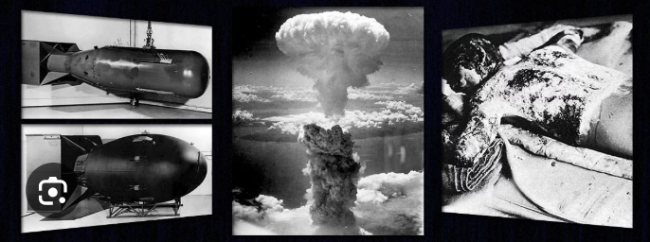
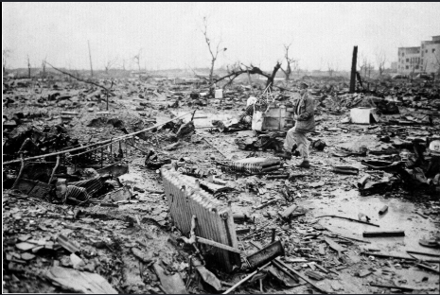

Slide 7

ROTARY INTERNATIONAL
Club Leadership Learning Seminar (CLLS)
“1950-1960: World no.1 in Textile industries.”
“1960-1970: World no.1 in Steel industries.”
“1970-1981: World no.1 in Automobile industries.”

Slide 8
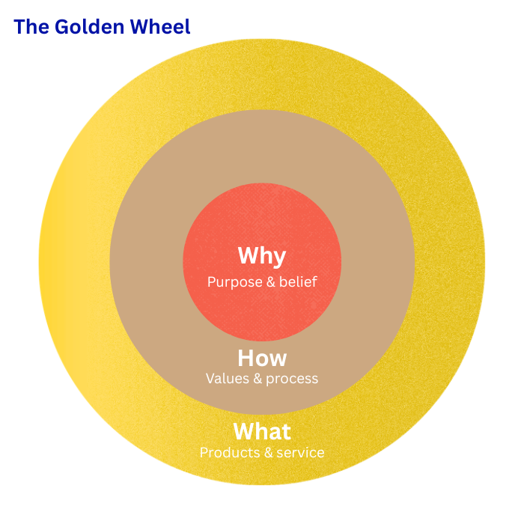
ROTARY INTERNATIONAL
Club Leadership Learning Seminar (CLLS)
“People don’t buy what you do, they buy why you do!”

Slide 9

What do you need to climb the mountain?

Slide 10
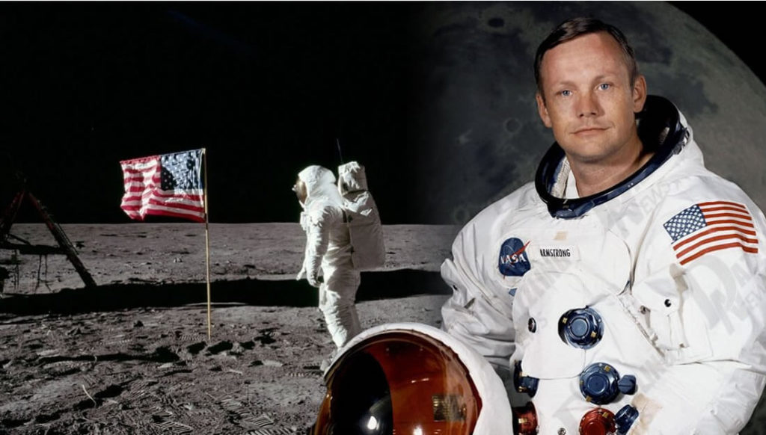
Neil Armstrong, 1969
This Photo by Unknown Author is licensed under CC BY-SA-NC

Slide 11

"If people don't know what you're doing,
they can't support you.
If they don't support you,
you can't change the world."
— Rotary International, Brand Center
🙋 QUICK SHOW OF HANDS:
How many of you can recall the last time someone outside Rotary knew about your club's biggest project?

Slide 12
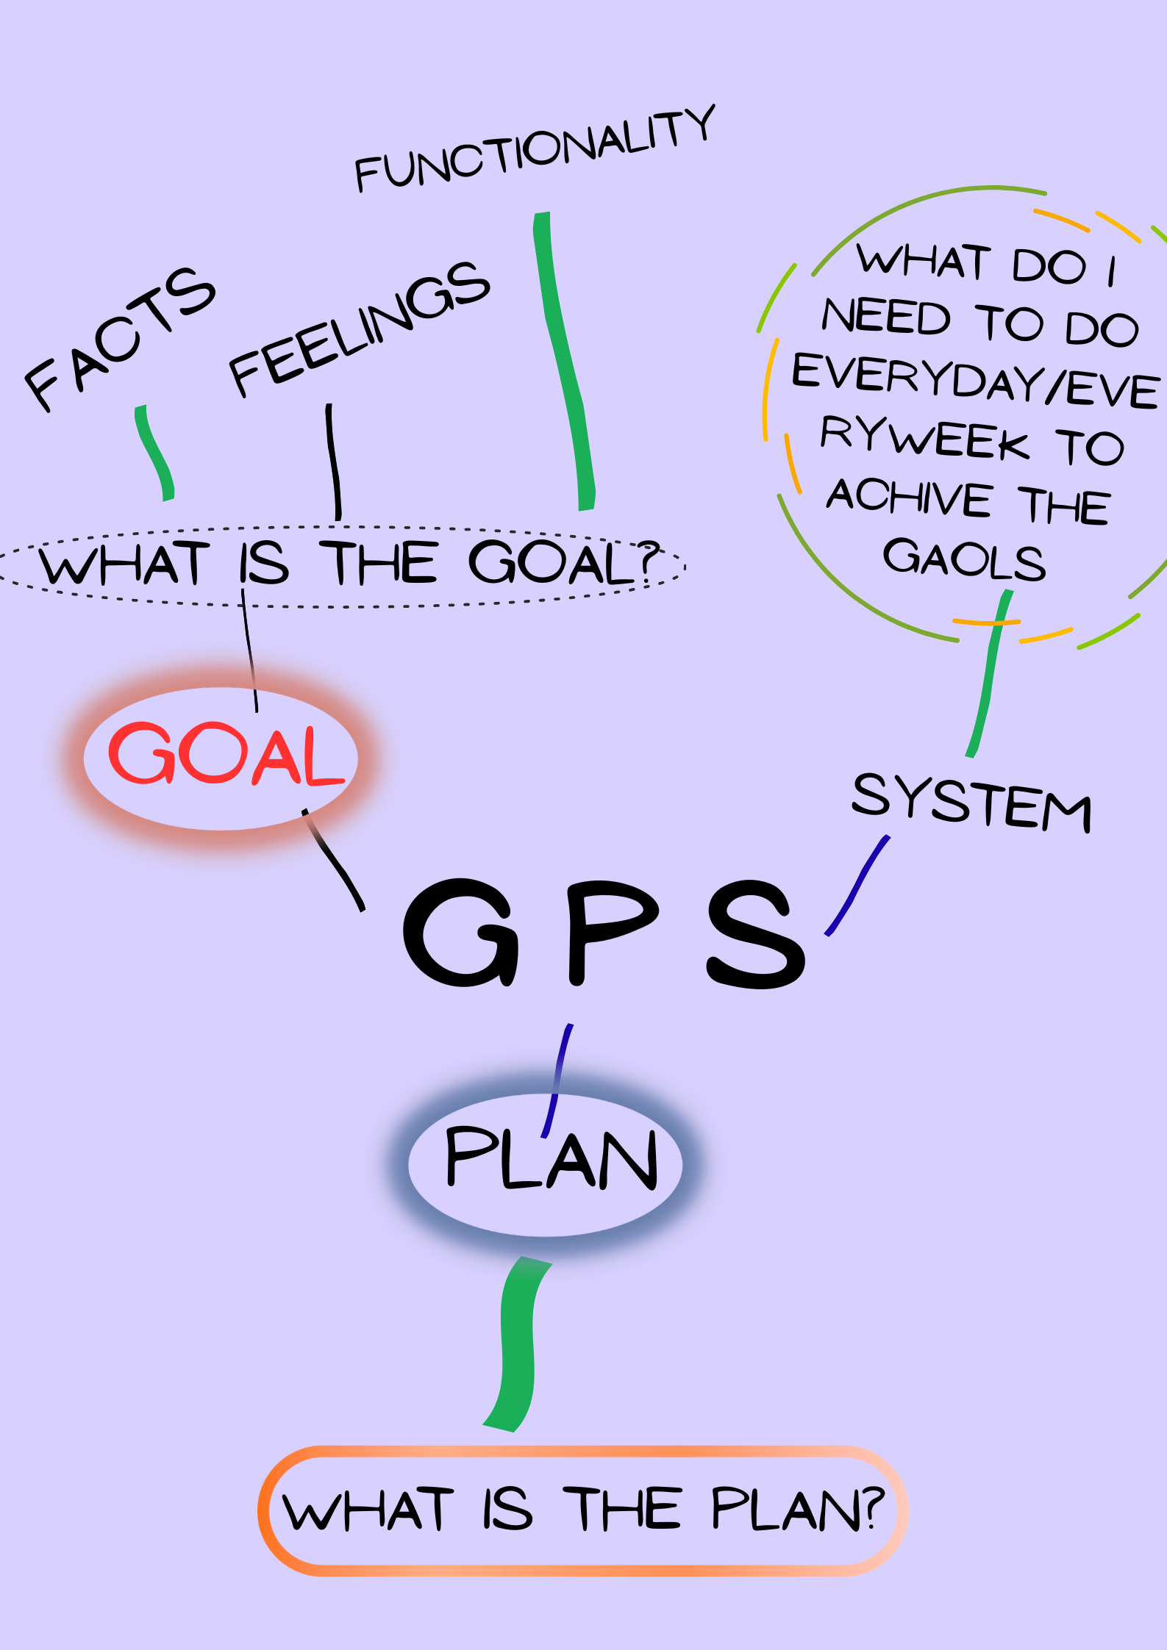
ROTARY INTERNATIONAL
Club Leadership Learning Seminar (CLLS)
A letter will reach nowhere….
1979 survey Harvard MBA student..84/13/3
Tragedy: 95% will never achive….
Consistently water drop on the stone on the same place….
Goal should be emotional driven..
  Goal sud be extraordinary
  Sud be different from others
  Brings energy/can’t waste time
  Enjoy the goal
  Break down the bigger goal to its smaller form
Everything in life happens twice, in the mind and reality…MJ.
method

Slide 13



UNDERSTAND THE LANDSCAPE
What Is Rotary's Public Image?
Public Image is how Rotary is perceived by the public — members, potential members, donors, community leaders, and the media. It is the sum of all impressions your club creates through actions, communications, and relationships.
VISIBILITY
RELEVANCE
CREDIBILITY
People see what you do. Your projects, events, and impact are visible in the community.
People connect with your mission. Your work addresses issues that matter to them.
People trust your club. Your actions match your words consistently.

Slide 14




WHY IT MATTERS
The Cost of Being Invisible
74%
3x
of people have never heard of Rotary's
major programs in their area
more volunteers when a club actively
promotes its work on social media
2x
68%
more donations when project stories
are shared with compelling visuals
of members say they joined because
someone personally told them Rotary's story

Slide 15




ROTARY'S FRAMEWORK
4 Levers of Club Public Image
01 Storytelling & Media
02 Digital Presence
Share project stories with photos & videos
Active club website & social media
Engage local media — press releases, TV, radio
Monthly posts minimum on FB/IG/LinkedIn
Use Rotary's Brand Center resources
Use #Rotary #PeopleOfAction hashtags
03 Community Engagement
04 Member Ambassadors
Speak at local events, chambers, schools
Every member is a brand ambassador
Partner with local NGOs & businesses
Elevator pitch for Rotary (30 seconds)
Host open-house or service days
Wear Rotary badge with pride

Slide 16
DEVELOP GOALS
The SMART+I Goal Framework for Public Image
S
SPECIFIC
M
MEASURABLE
A
ACHIEVABLE
Name the exact activity, channel, or audience — not just 'improve our image'
Attach a number — followers, press mentions, event attendance, impressions
Stretch but realistic. Match your club's size, budget, and volunteer capacity
Example: 'Post a project update on Facebook every Tuesday'
Example: 'Reach 500 Facebook followers by December'
Example: 'Secure 2 local newspaper mentions per quarter'
R
RELEVANT
T
TIME-BOUND
I
INCLUSIVE
Tied to a real community need or membership growth priority
Set a deadline — monthly, quarterly, or by end of Rotary year
Assign an owner and involve multiple members — not just the PI Chair
Example: 'Target working professionals aged 30–45 via LinkedIn'
Example: 'Launch new club website by 30 September'
Example: 'Each member shares one post per month'

Slide 17



🎯 GROUP ACTIVITY — 10 Minutes
Build 3 Public Image Goals for YOUR Club
Divide into 3 groups. Each group picks ONE area below and writes a SMART+I goal. Present back in 2 minutes!
GROUP 1: Digital & Social Media
✍ Write your goal
Write a goal to grow your club's online presence. Which platform? How many posts? How many followers by when?
GROUP 2: Media & Storytelling
✍ Write your goal
Write a goal to get press coverage or tell your project stories better. Which project? Which media? How often?
GROUP 3: Member Ambassadors
✍ Write your goal
Write a goal to activate every member as a public image ambassador. What will each member do? How will you track it?

Slide 18
PRACTICAL EXAMPLES
5 Ready-to-Use Public Image Goals
Social Media Consistency
💡 Consistent posting builds familiarity and trust over time.
01
Post at least 3 times per week on Facebook/Instagram showcasing our service projects, with photos and the #PeopleOfAction tag — measured by page reach, target: 20% growth in 6 months.
Media Relations
💡 Media coverage reaches thousands who wouldn't otherwise know about Rotary.
02
Submit press releases for every major project to at least 3 local media outlets, and achieve a minimum of 6 media mentions in the Rotary year.
Community Speaker Programme
💡 Personal engagement is the most powerful public image tool.
03
Have club members speak at 4 community events (schools, chambers, NGOs) per quarter, sharing Rotary's mission and inviting partnerships.
Website & SEO Update
💡 Your website is your 24/7 ambassador — make it work for you.
04
Revamp the club website with a new project gallery, member stories, and meeting information by September 30 — and achieve first-page Google results for 'Rotary [your city]'.
Member Ambassador Challenge
💡 Authentic peer-to-peer sharing multiplies your reach exponentially.
05
Every member recruits one guest per quarter and shares one Rotary story per month on personal social media — tracked via a simple monthly check-in form.

Slide 19
ACTION PLANNING
Tools & Quick Wins for Your Club
🛠 FREE ROTARY TOOLS
⚡ QUICK WINS THIS WEEK
Rotary Brand Center (brandcenter.rotary.org) — logos, templates, photos
Day 1
Audit your last 10 Facebook posts — do they tell a story?
Rotary's Social Media Playbook — downloadable guides
Day 2
Identify your club's 3 most impactful projects and write one-paragraph stories for each
My Rotary Platform — club website toolkit
Day 3
List 5 local media contacts and assign a member to each
Rotary Showcase — share project impact stories globally
Day 4
Draft your 30-second Rotary elevator pitch as a club
PR & Media Kit — press release templates, talking points
Day5
Create a shared WhatsApp/group to reshare each other's Rotary posts
Rotary International Facebook Group — global community tips
This Month
Set your 3 SMART public image goals and assign owners!

Slide 20

INDIVIDUAL COMMITMENT
My Public Image Goal for This Rotary Year
Complete your commitment card (keep it — review it at next CLLS or board meeting!)
My Club:
My Name / Role:
My #1 Public Image Goal for this year:
Deadline:
I will measure success by:
My first action step (this week) is:

Slide 21


REMEMBER
Public image is everyone's responsibility — not just the PI Chair.
You don't need a big budget — you need consistency and heart.
Start with 1 goal. Execute it well. Then add another.
Every project is a story. Every story is an opportunity.
YOUR CLUB.
YOUR STORY.
YOUR WORLD.
The world needs to know what Rotarians do. Tell them.
"Service Above Self" — begins with making sure the world knows you exist and what you stand for.

Slide 22

ROTARY INTERNATIONAL
Club Leadership Learning Seminar (CLLS)
Prepared by:
Rtn Robin Shrestha
Assistant Governor
Zone:43, R7
Rotary Club of Dharan

