Slide 1


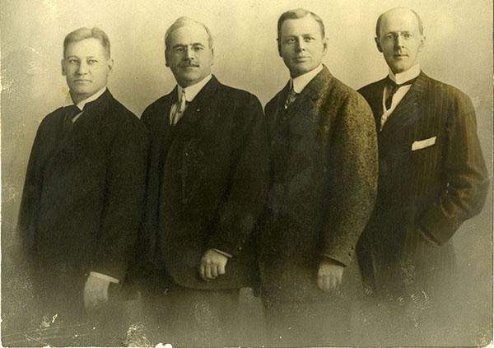
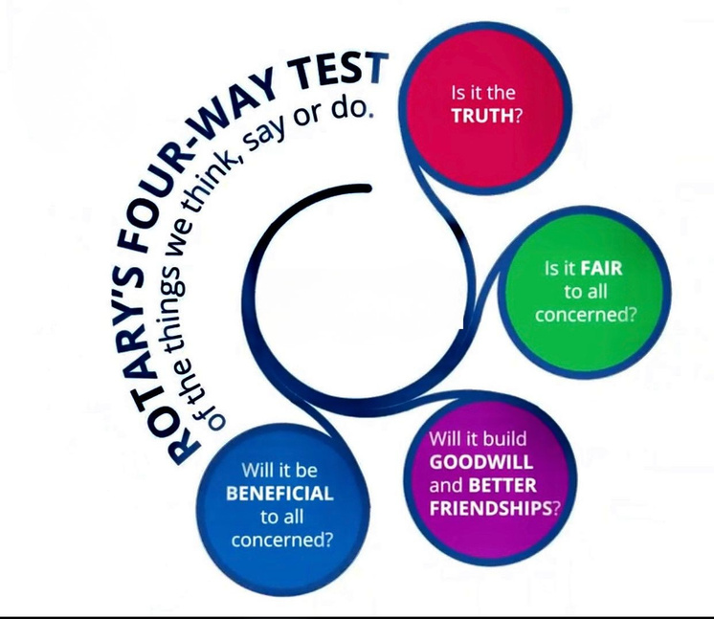
Membership Committee
Roles & Responsibility

Slide 2

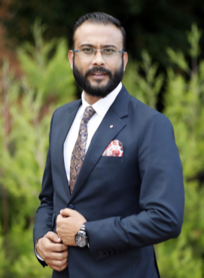
RTN. BISHNU HARI DAHAL
RI District 3292 Involvement
PRESIDENT, ROTARY CLUB OF MATRIBHUMI BALUWATAR 2018-19
MEMBER - DISTRICT ROTARACT COMMITTEE 2019-20
CHAIR - DISTRICT INTERACT COMMITTEE, 2020-21
CHAIR - DISTRICT ROTARACT COMMITTEE, 2021-22
ASSISTANT GOVERNOR ZONE 1, 2022-23
CHAIR - DISTRICT ROTARY PROGRAMME COMMITTEE, 2023-24
CO- CHAIR - DISTRICT LEARNING FACILITATOR 2024-25
MEMBER - DISTRICT LEARNING FECILITATOR 2025-26
CHAIR - DISTRICT MEMBERSHIP COMMITTEE 2026-27

Slide 3
RTN. BISHNU HARI DAHAL
Rotary International Involvements
CHAIR– ROTARY FELLOWSHIP FOR LEADERSHIP EDUCATION AND DEVELOPMENT, 2026-2027
CHAIR – INTER COUNTRY COMMITTEE, NEPAL-PORTUGAL SINCE 2024
CHAIR – ROTARY MEANS BUSINESS DISTRICT 3292 SINCE 2023
CHARTER MEMBER - ROTARY FELLOWSHIP FOR LEADERSHIP EDUCATION AND DEVELOPMENT SINCE 2021

Slide 4
Rotary Highlights
Founded in 1905 in Chicago 120 Years of Legacy & Service
Global network of 1.4+ million members in over 46,000 clubs.
Strong focus on Service Above Self
Presence in 200+ countries.
Seven Focus Areas of Service
Leading role in Polio eradication (99.9% reduction).

Slide 5
“रोटरीमा सदस्य भित्र्याउनु मात्र पर्याप्त होइन,
रोटरीका मूल्य, नैतिकता, सेवा भावना र
"Service Above Self" को आदर्शलाई
उहाँको जीवनमा स्थापित गर्नु नै हाम्रो वास्तविक
सफलता हो। सदस्यता संख्या होइन, संस्कार र
सेवाप्रतिको प्रतिबद्धता हो।

Slide 6
#
Roles & Responsibilities of Membership Committee Chair

Slide 7
#
Topics we will discuss
Membership Development Planning
Engagement & Participation
Ethical & Quality Membership
Orientation & Induction
Membership Growth
Leadership Pipeline Development
Member Retention

Slide 8
#
Membership Development Planning
Prepare annual membership goals and action plans
Analyze membership trends, demographics, and retention rates.
Coordinate with leadership for sustainable growth.

Slide 9
#
Orientation & Induction
Organize proper onboarding for new members.
Create mentorship systems for smooth integration.
Educate members about organizational values, ethics, traditions, and opportunities.

Slide 10
#
Membership Growth
Develop strategies to attract quality and service-minded members.
Promote the vision, culture, and impact of the organization.
Identify prospective members through networking, events, and referrals.

Slide 11
#
Member Retention
Ensure members feel valued, connected, and involved.
Monitor attendance, participation, and engagement.
Address concerns, conflicts, or dissatisfaction early.

Slide 12
#
Engagement & Participation
Encourage active participation in projects, fellowship, and leadership roles.
Match members’ skills and interests with club activities.
Build an inclusive and welcoming culture.

Slide 13
#
Ethical & Quality Membership
Focus on values, integrity, diversity, and professionalism rather than numbers alone.
Encourage balanced and inclusive representation.
Protect organizational culture and standards.

Slide 14
#
Leadership Pipeline Development
Identify potential future leaders
Encourage learning, training, and committee involvement.
Support succession planning within the organization.

Slide 15
#
Take Away to Club
“Membership is not about
increasing numbers; it is
about creating belonging,
purpose, participation, and
future leadership.”

Slide 16
Q&A
Session

Slide 17

Thank you
Yours In Rotary
Rtn. Bishnu H. Dahal

